Slide 1
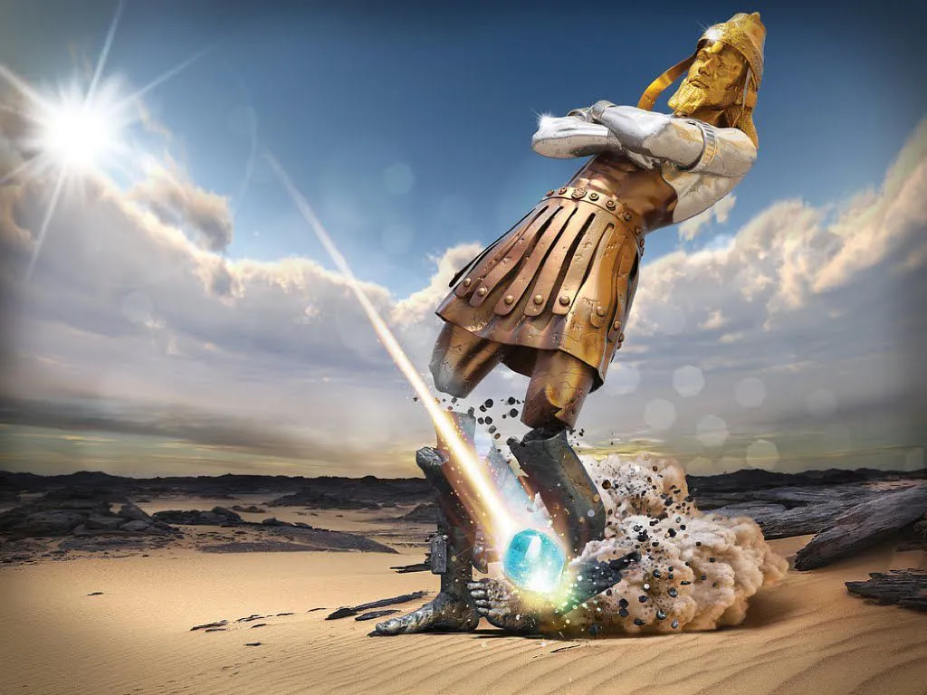


God’s plan of the ages

Slide 2
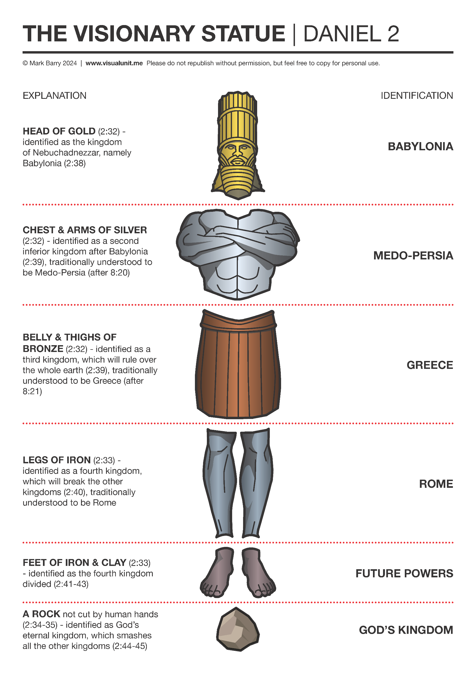
Prophecy in Daniel
the canvas
the commander
the calendar
the consummation

Slide 3
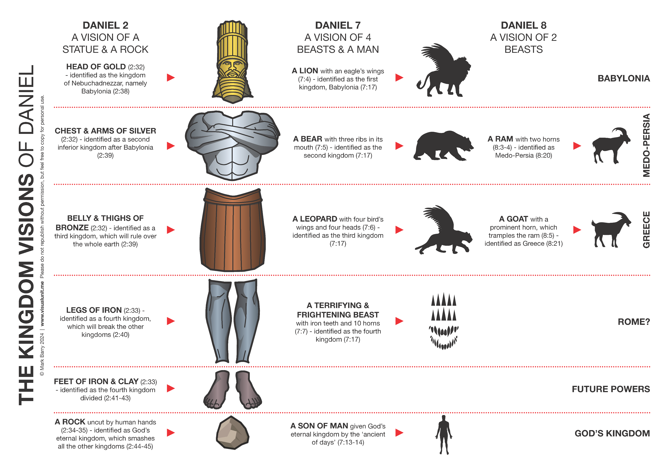
PHASE 1
PHASE 2
THE CHURCH AGE

Slide 4
The [satanic] commander
vision 1 – little horn
Vision 2 – fierce king
vision 3 – Coming Prince
Vision 4 – Wilful king

Slide 5
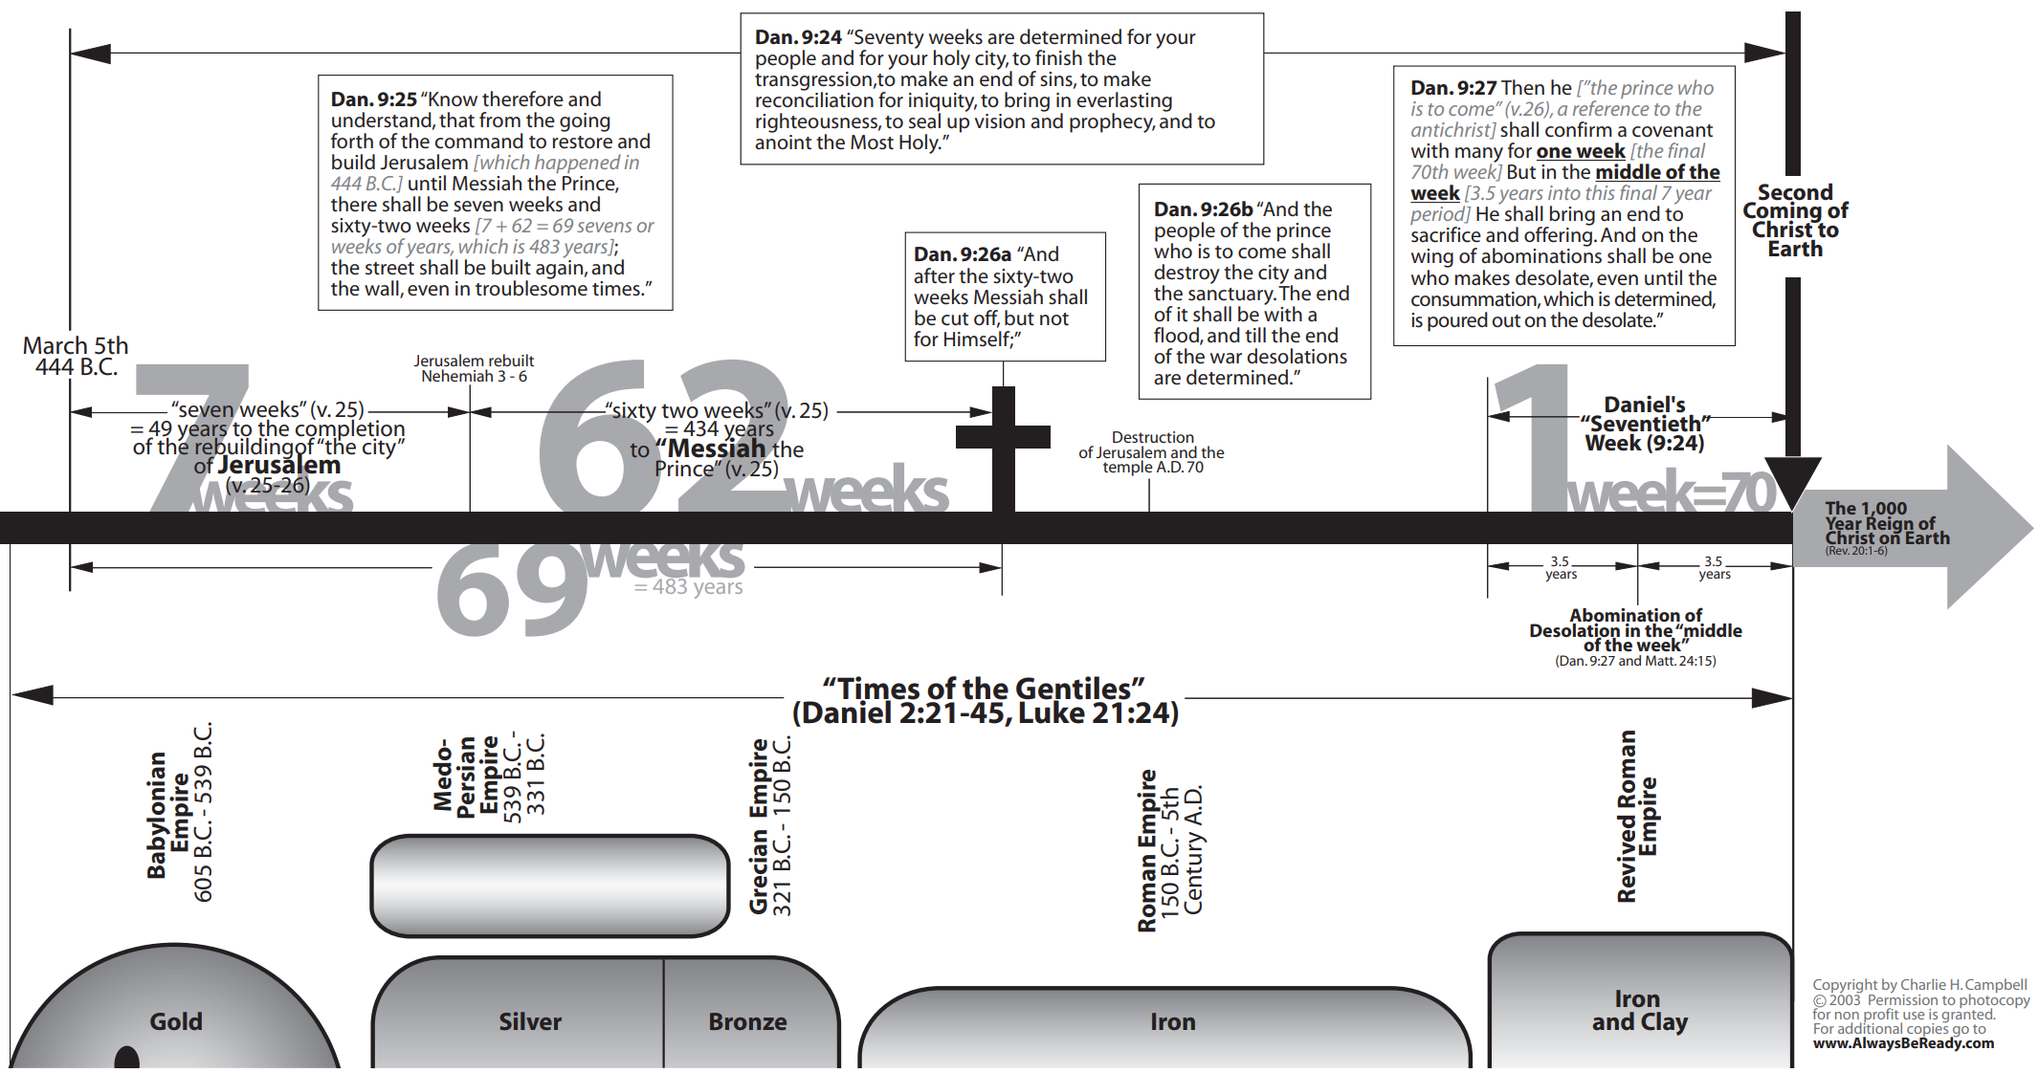
The [unique] calendar

Slide 6
The [Glorious] consummation
Christ will reign [7.13-14]
saints will be raised [12.2]
Daniel was to rest [12.13]

