Slide 1
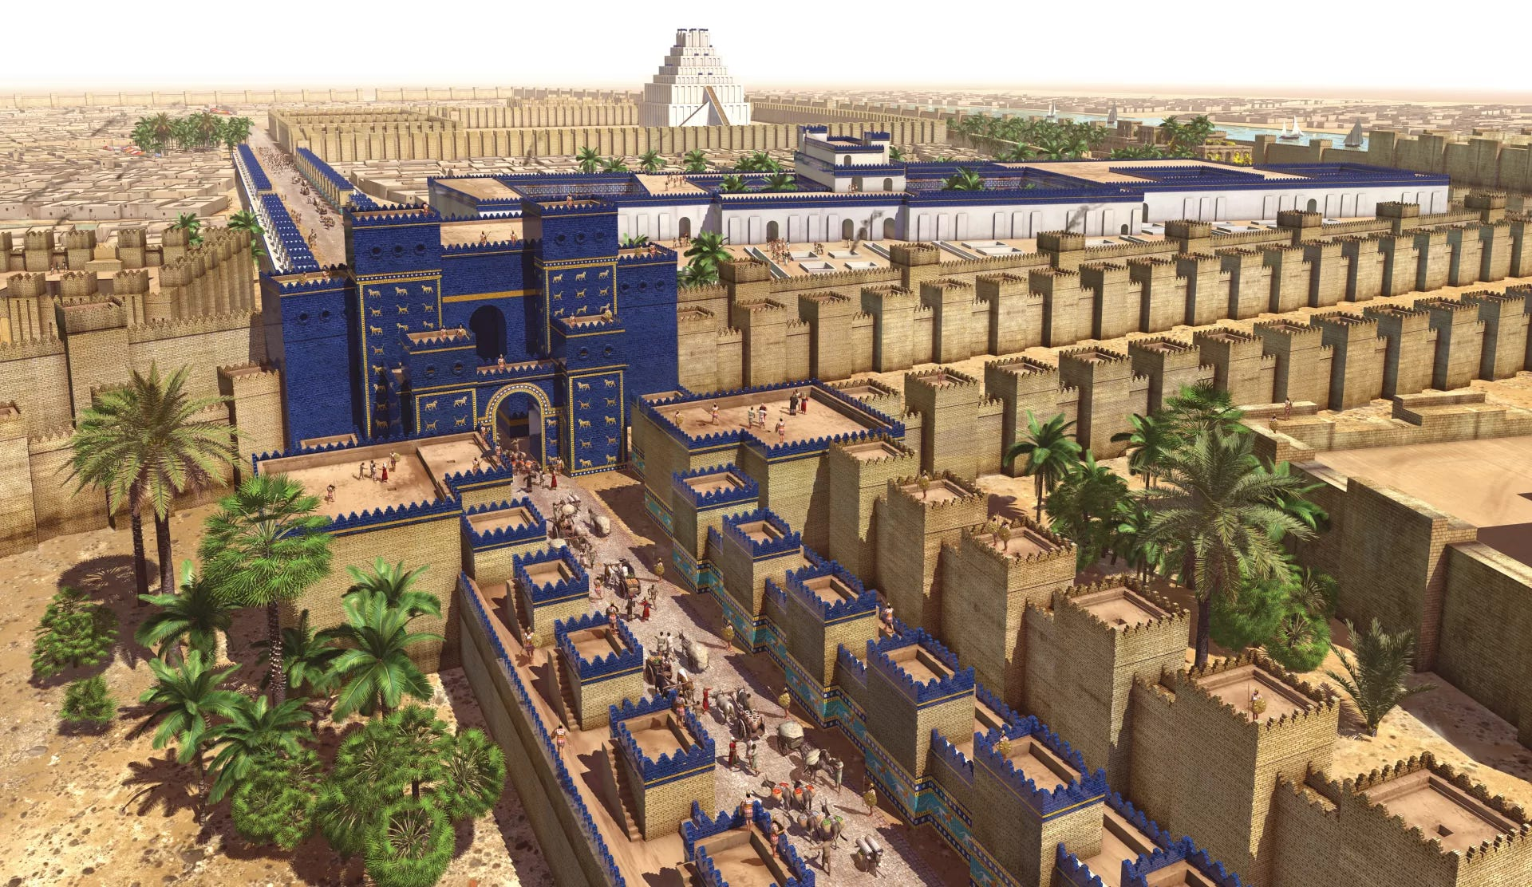
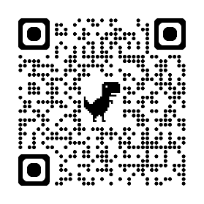

The book of daniel

Slide 2
The book of Daniel
subject of the book
scene of the book
setting of the book
structure of the book
saviour in the book

Slide 3
The subject of the book
kings and kingdoms
“thou, o king, art a king of kings” (dan. 2.37)
“Now I nebuchadnezzar praise and extol and honour the king of heaven” (Dan. 4.37)

Slide 4
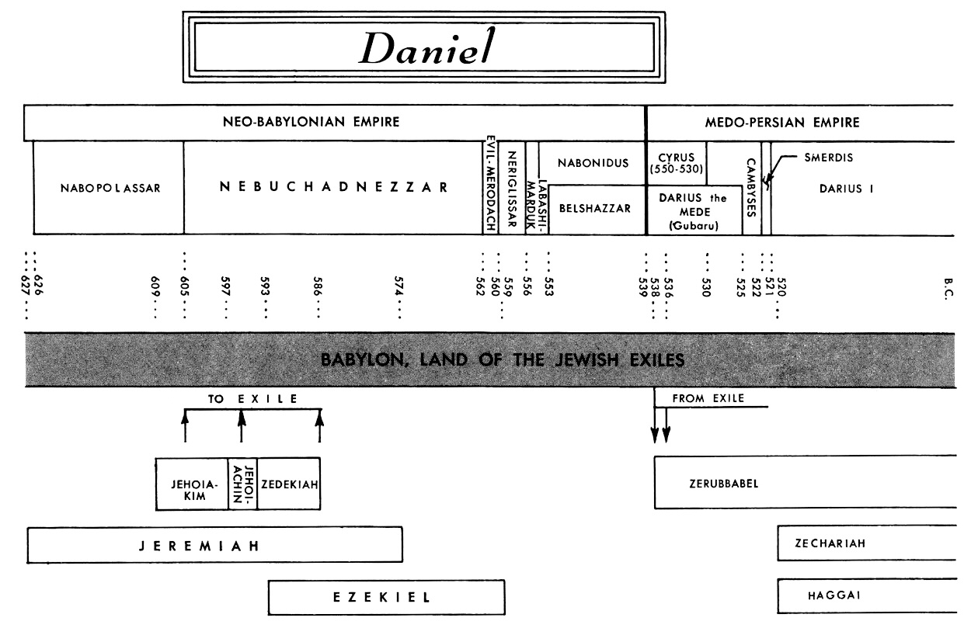
The scene of the book

Slide 5
The setting of the book
major prophet
Jeremiah [covenant]
Ezekiel [city]
Daniel [calendar]
Isaiah [cross]

Slide 6
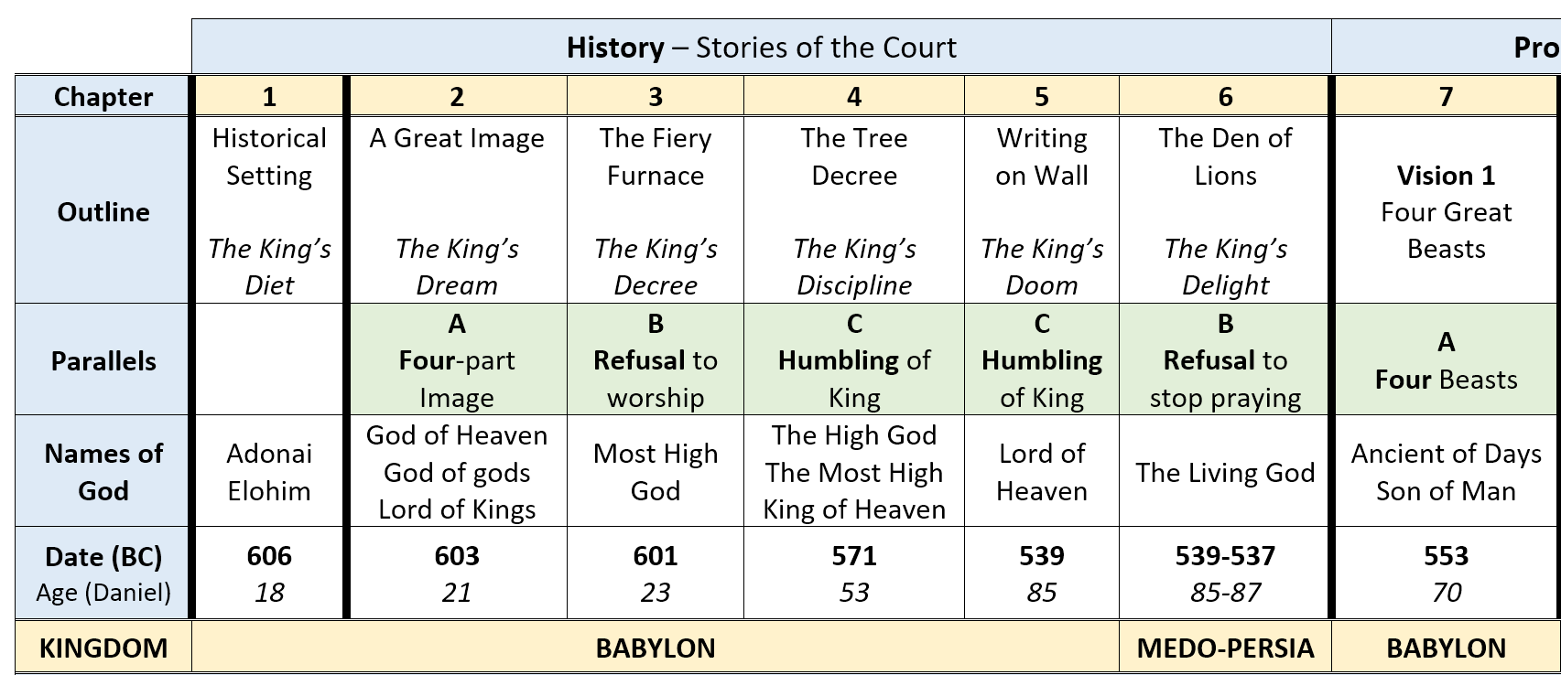
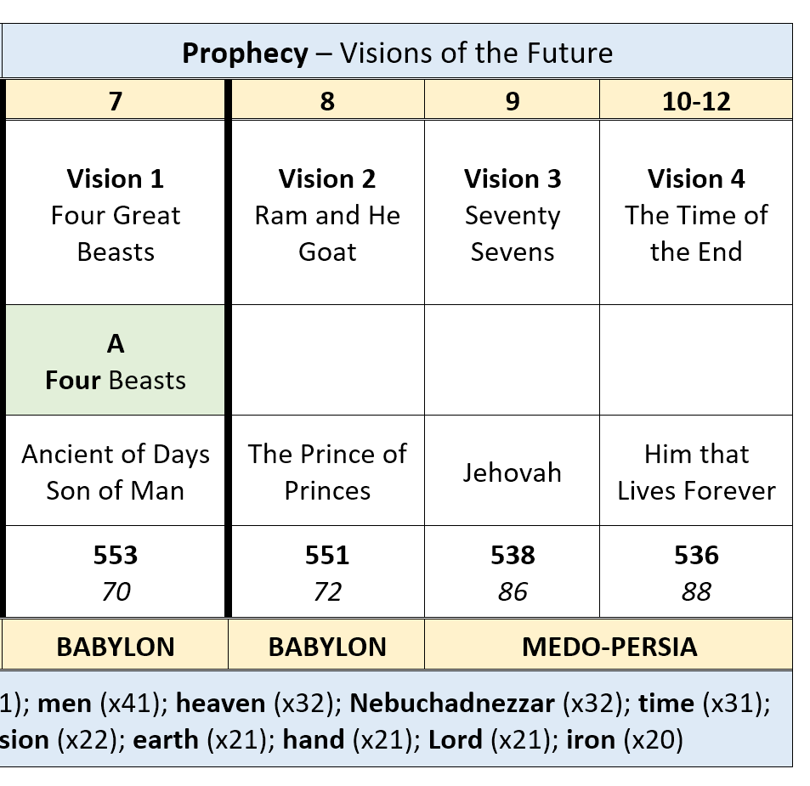
The structure of the book

Slide 7
The saviour in the book
servant – Daniel as a type
stone [2]
son of god [3]
son of man [7]
sovereign – man in linen [10]

