Slide 1
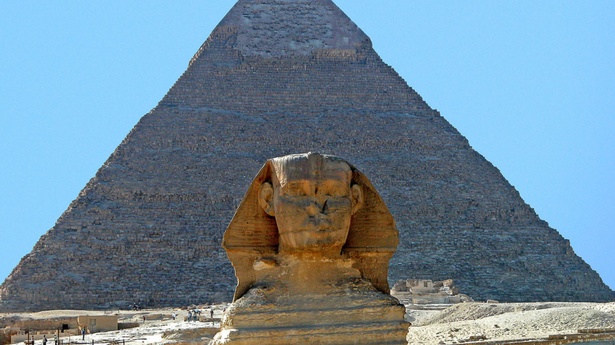

“The great artist of all things, enamoured by the wondrous cross, filled the world with foreshadowings and anticipations of it long before it stood with outstretched hands on the little hill of Calvary. The sun which now shines, so to speak, from the other side of the cross, so as to fling its shadow forward on the canvas of the present, once shone from where we now stand and flung its shadow backward upon the canvas of the past. One of these shadows is caught and photographed for us in the sweet story of Joseph.”
A character study: joseph

Slide 2
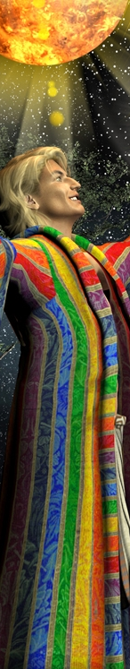
1. Scriptural
Psalm 105: divine providence
acts 7: despised prophet
Hebrews 11: divine promise

Slide 3
2. structural
son in father’s house [gen. 37]
servant in Potiphar’s house [gen. 39]
sufferer in prison house [gen. 40]
sovereign in pharaoh’s house [gen. 41-50]

Slide 4
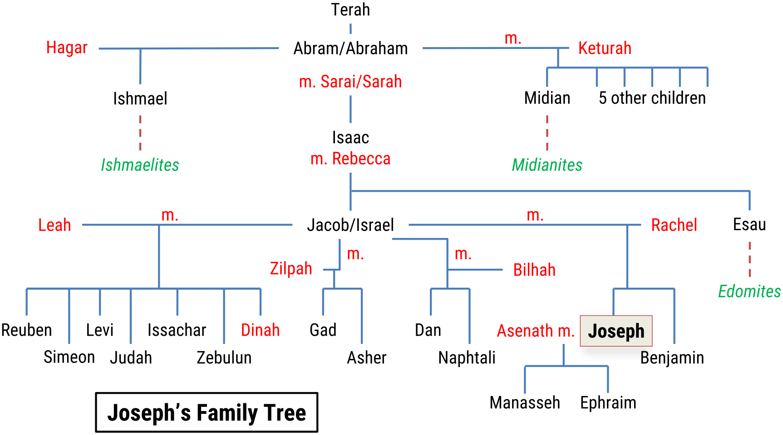
3. biographical
clan
calling
character

Slide 5
4. topical
tears
faith, hope & love
garments
  Distinction [coat of many colours]
  Devotion [Potiphar’s house]
  Disdain or derision [prison]
  Dignity [vestures of fine linen]

Slide 6
5. typical
joseph the son [Gen. 37]
delight of his father [37.1-4]
destined to reign [37.5-11]
despised by his brethren [37.12-24]
Delivered from the pit [37.25-28]

Slide 7
6. dispensational

Slide 8
7. Practical
joseph the teenager [Gen. 37]
huge potential
pressures of teenage life
Problems with his brothers
Purity of life

