Slide 1
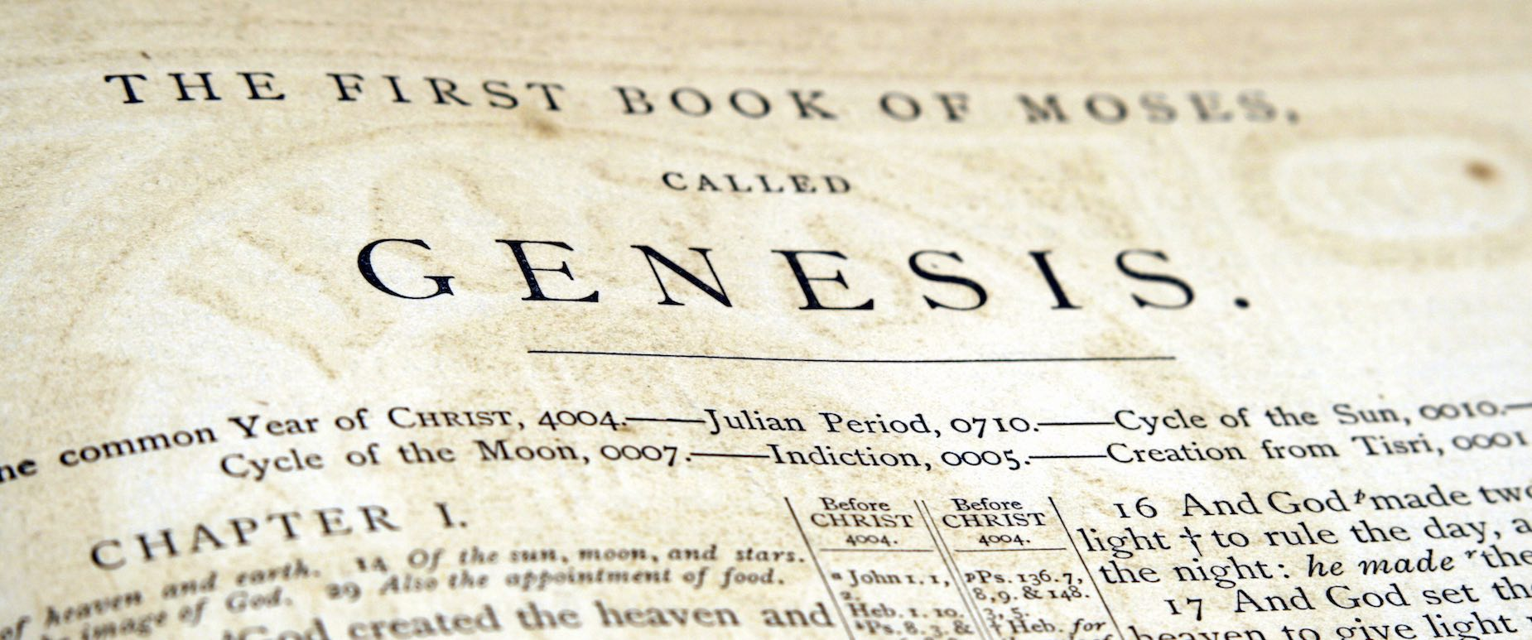

An overview of genesis

Slide 2

The story of the book
Bĕrēʾšît [Hebrew]= “in the beginning”
geneseos [Greek] = ‘origin’ or ‘generation’
tôlēdôt = the story of…
span of the story
subject of the story
success of the story

Slide 3
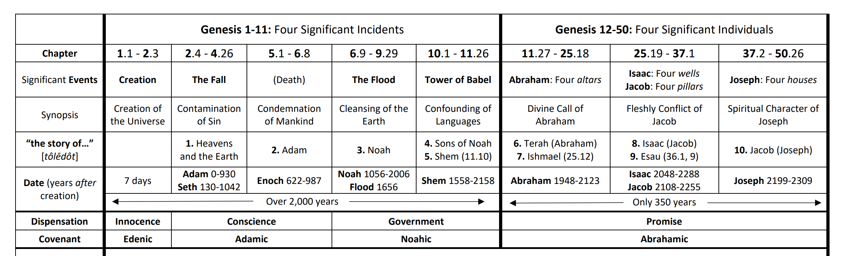
The structure of the book
Two division structure
Tôlēdôt structure
Turning point [genesis 12.1]

Slide 4
The subjects of the book
person of god [plurality, powerful, personal, perfect, pure, promise]
pictures of christ [Seed, shepherd, sovereign priest, son, saviour, Shiloh]
prologue [1.1-2.3]

Slide 5
The “seven” of the book
abel = man of sacrifice
enoch = man of separation
noah = man of sanctification
abraham = man who sojourned
isaac = man of submission
jacob = man of service
joseph = man of the spirit

Slide 6
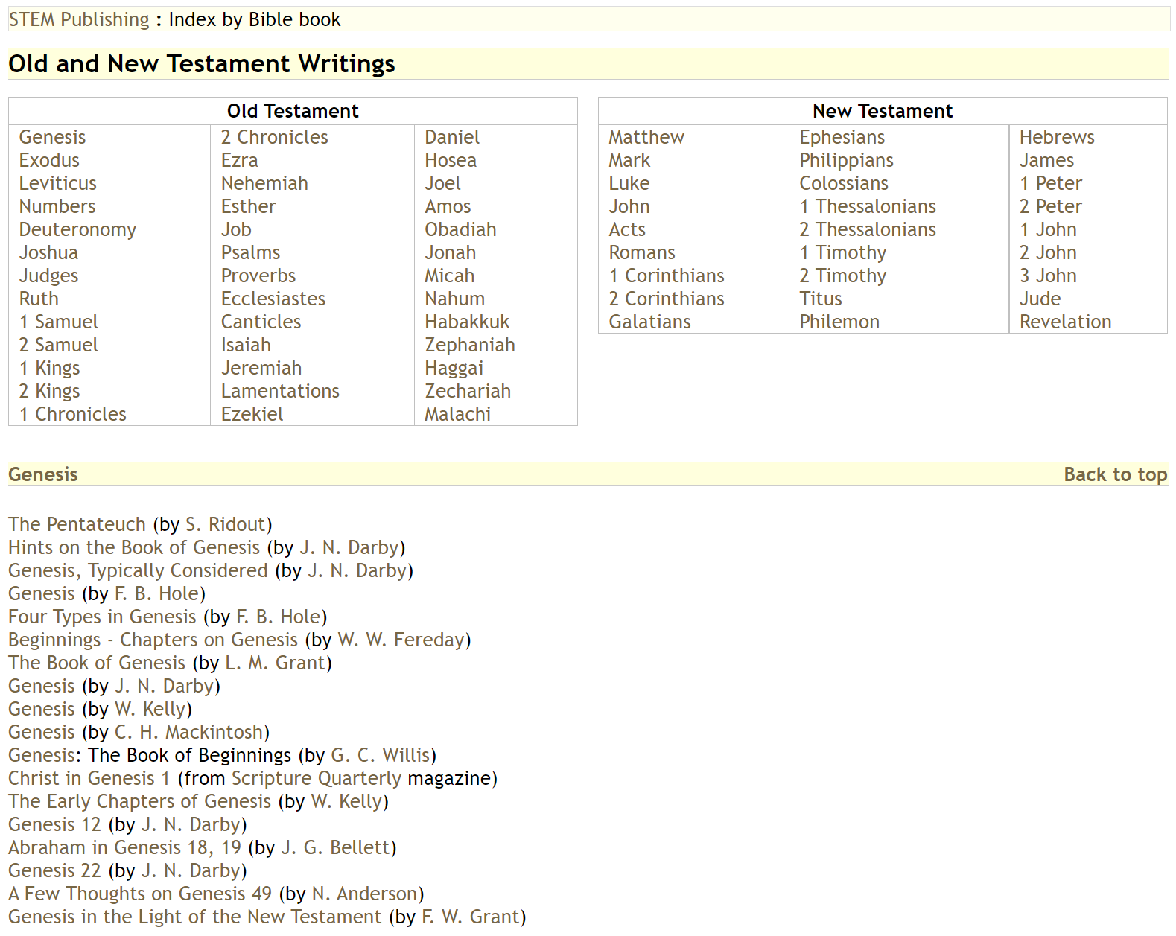
resources

Slide 7
resources
Books
J Sidlow baxter: “explore the book”
IL Jensen: “survey of old testament”
Arnold fruchtenbaum: “Genesis”
richard catchpole: “Beginnings”
Henry morris: “The genesis record”
David Dorsey: “literary structure”

Slide 8
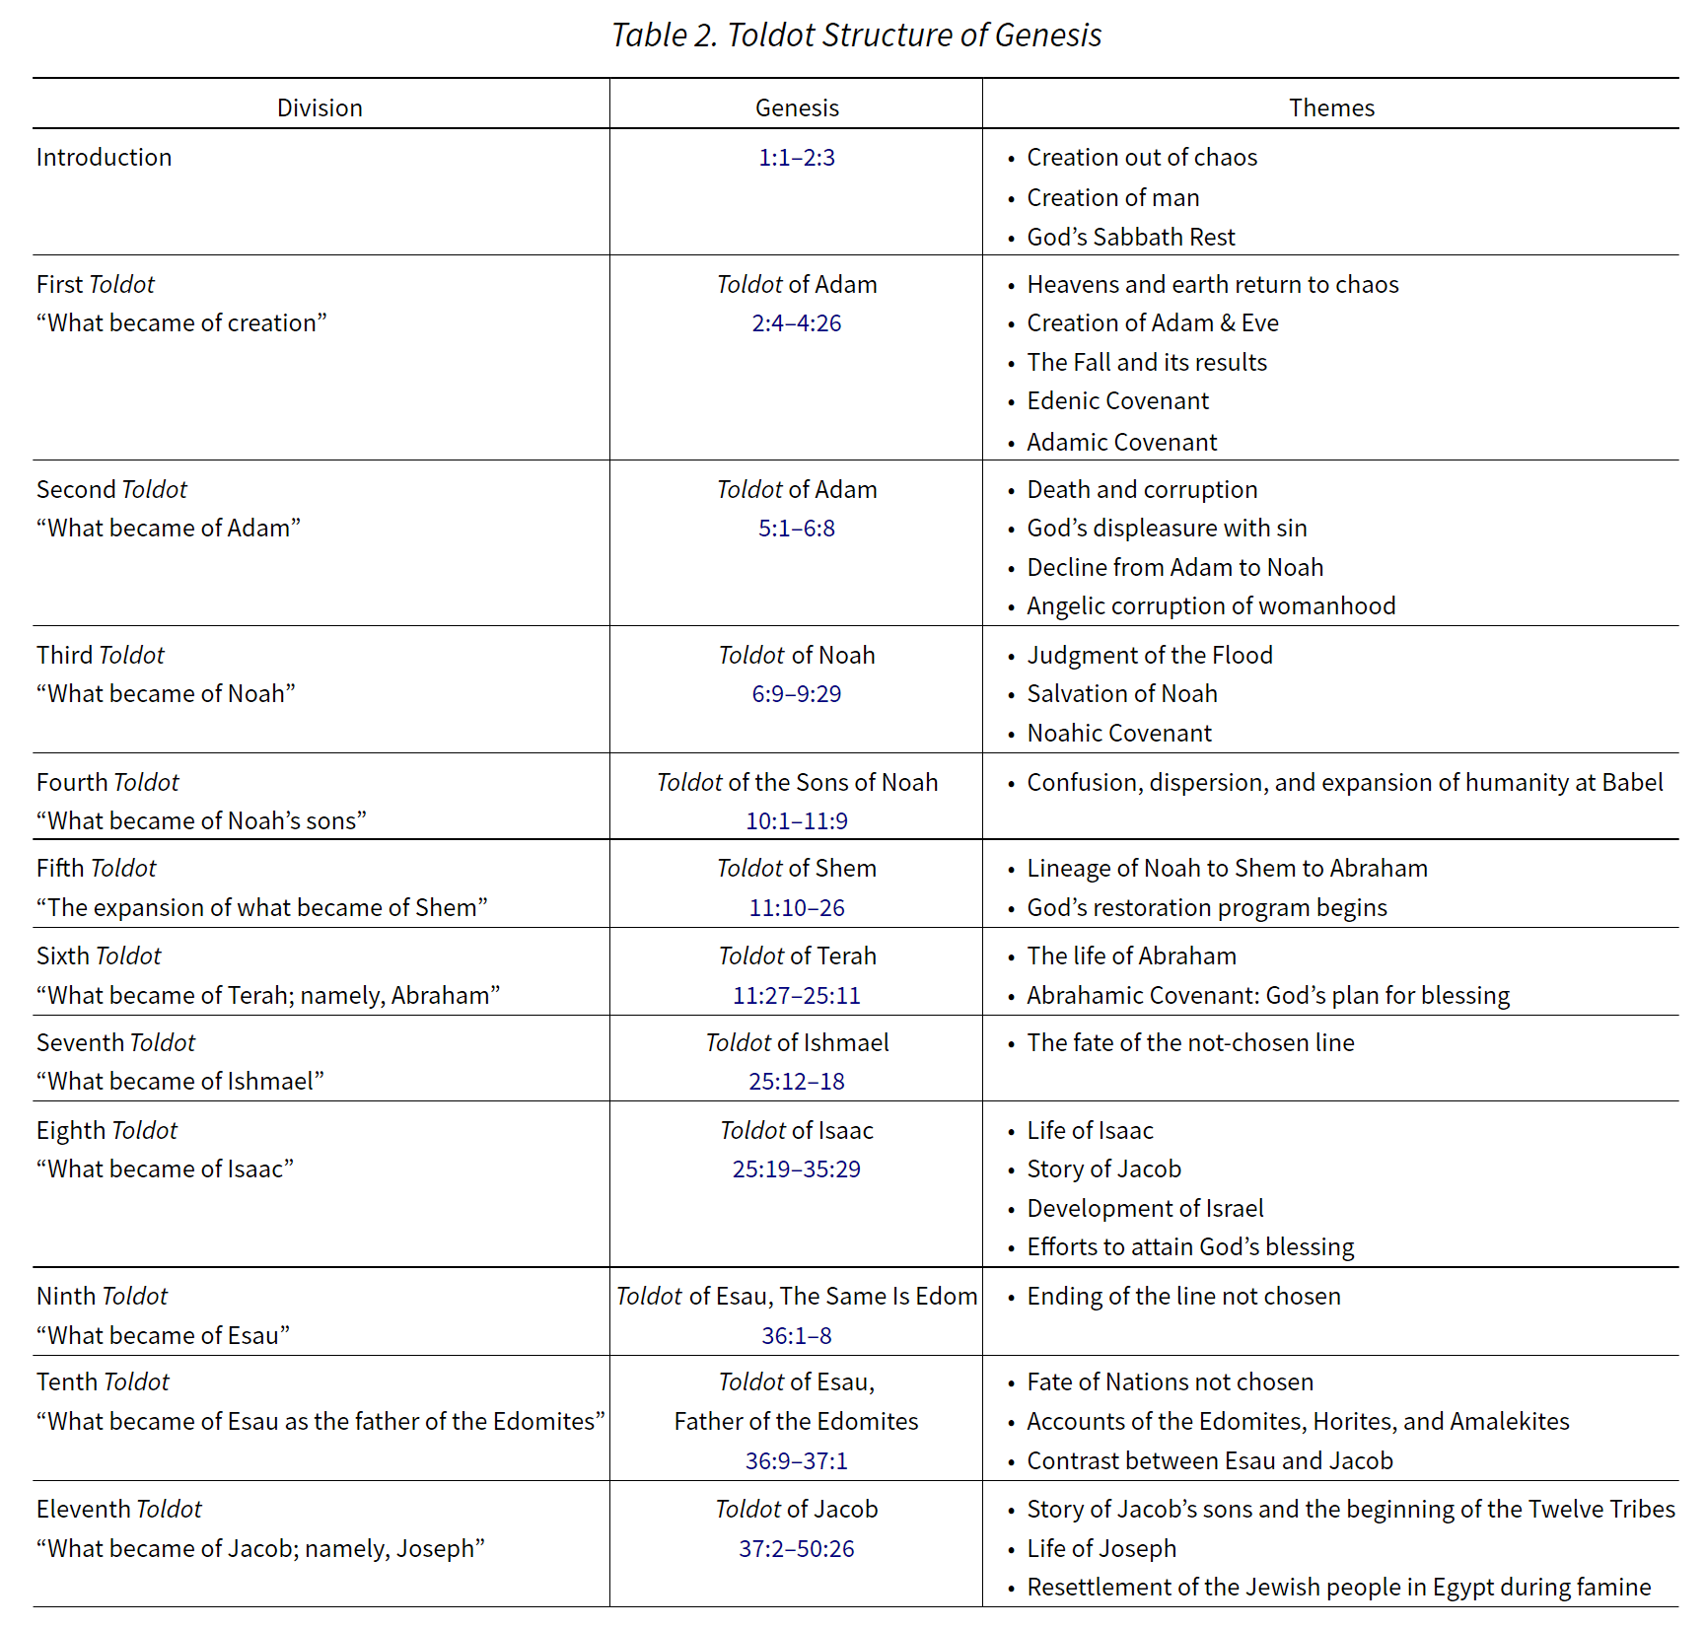
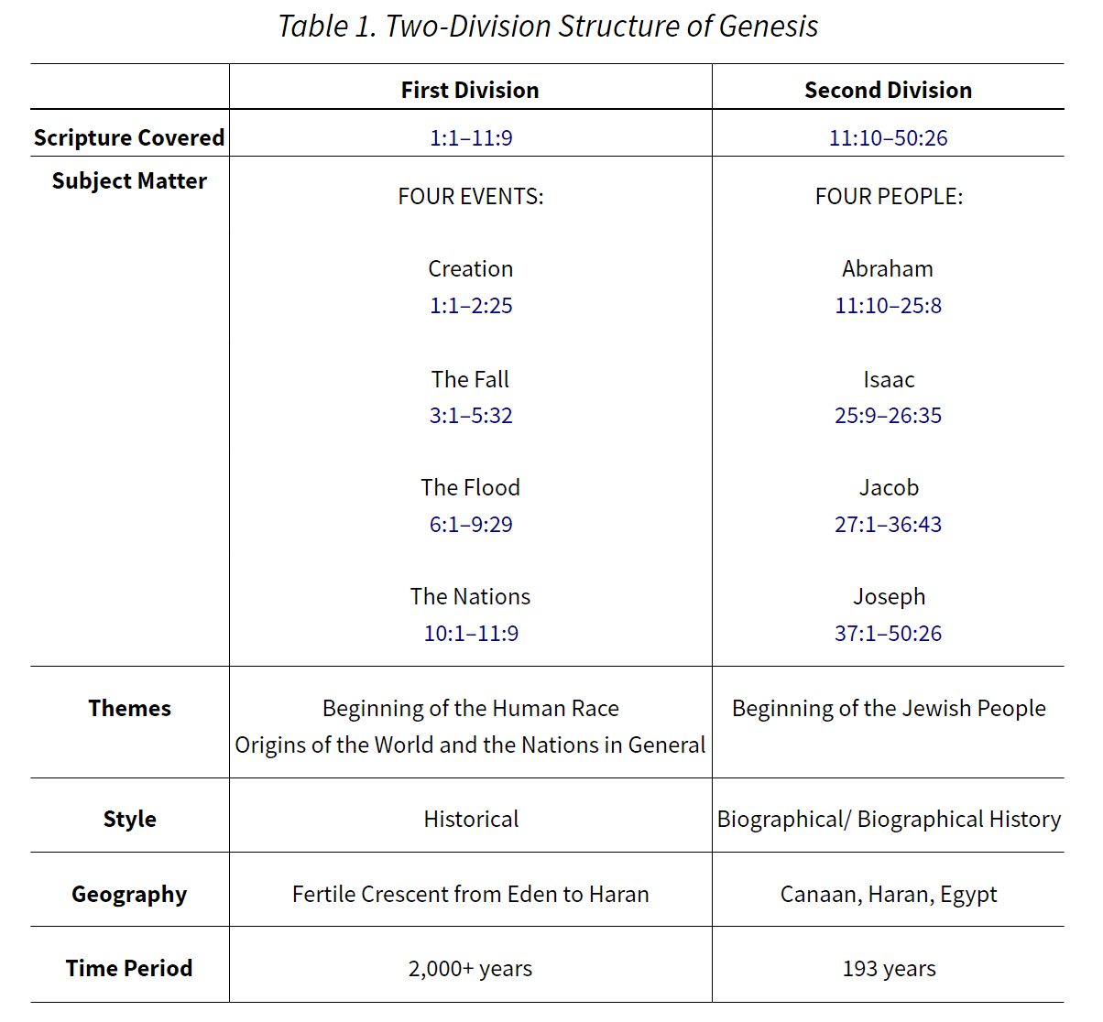
resources

Slide 9
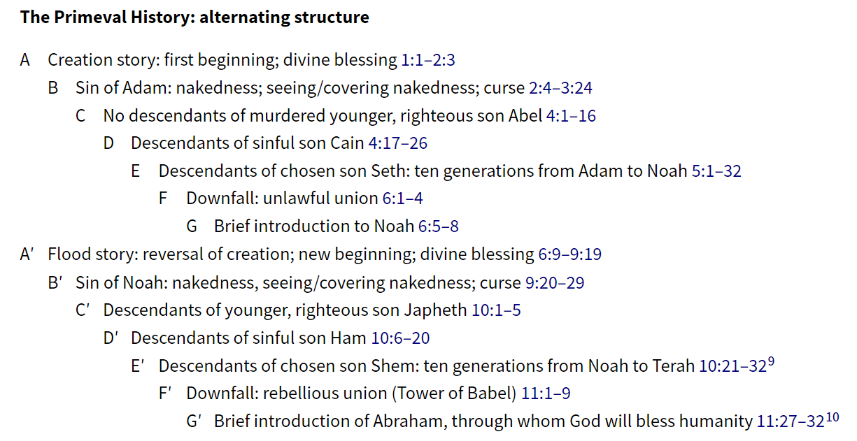
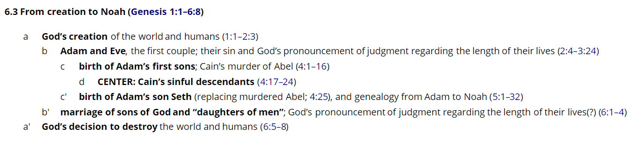
resources

Slide 10
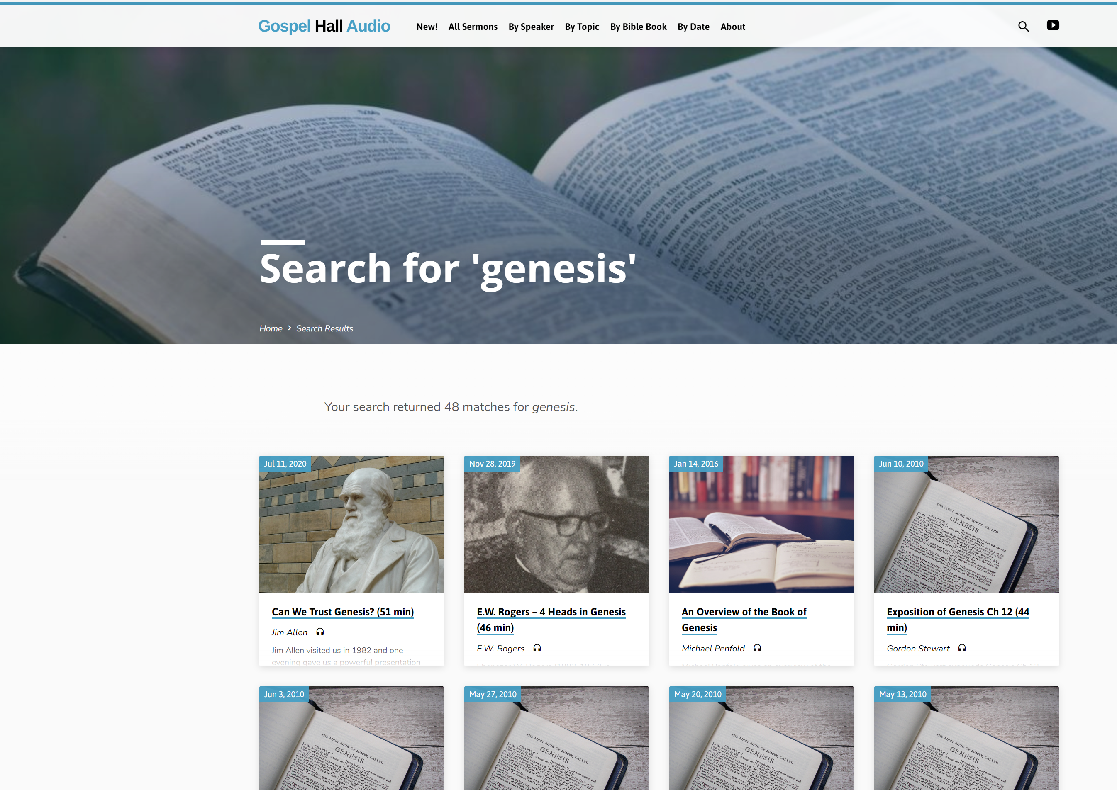
resources
Audio

Slide 11
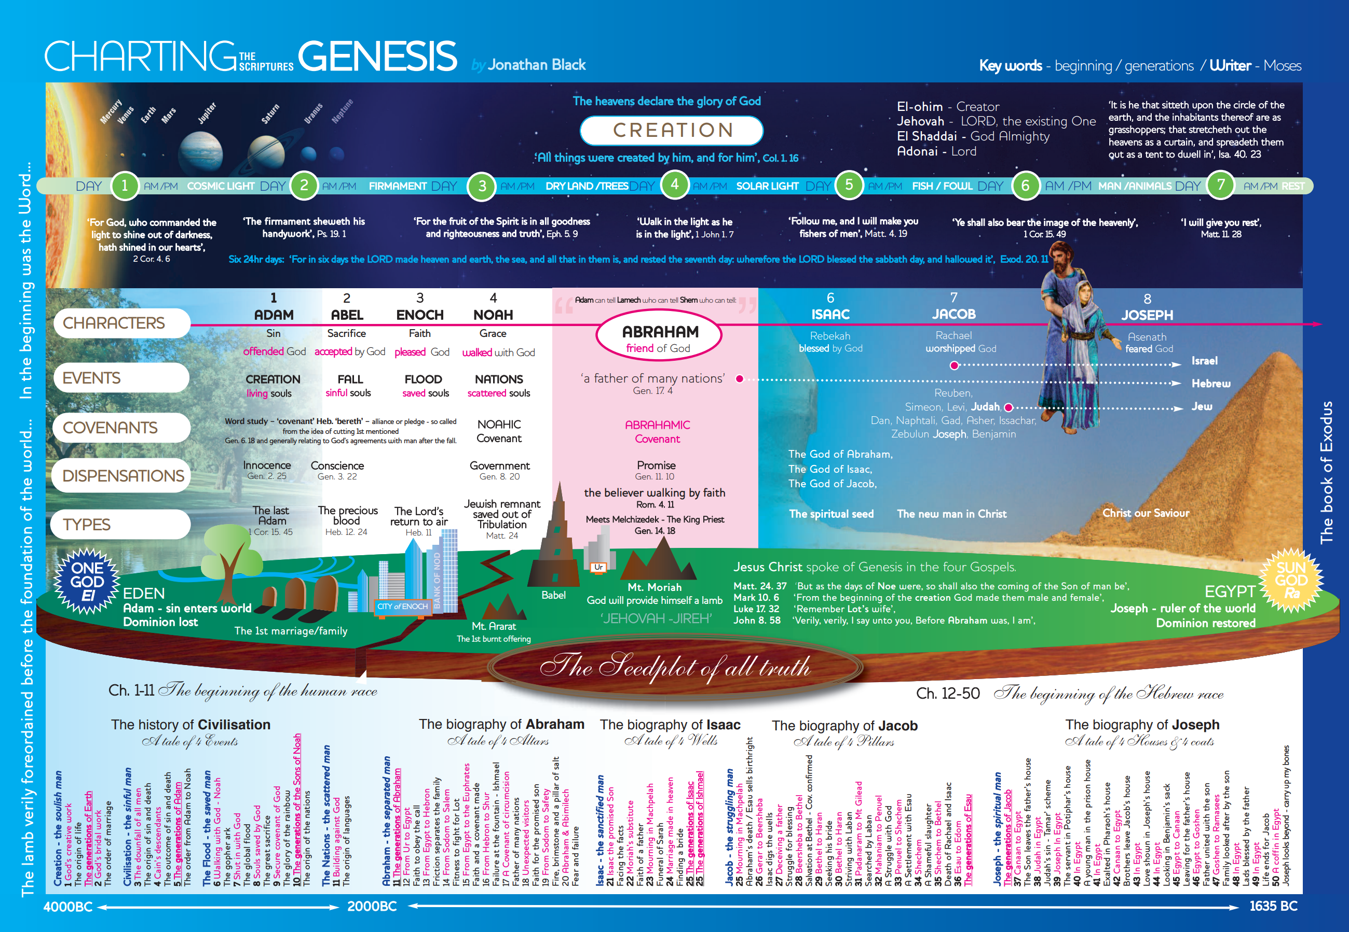
resources
Assembly websites

