Slide 1
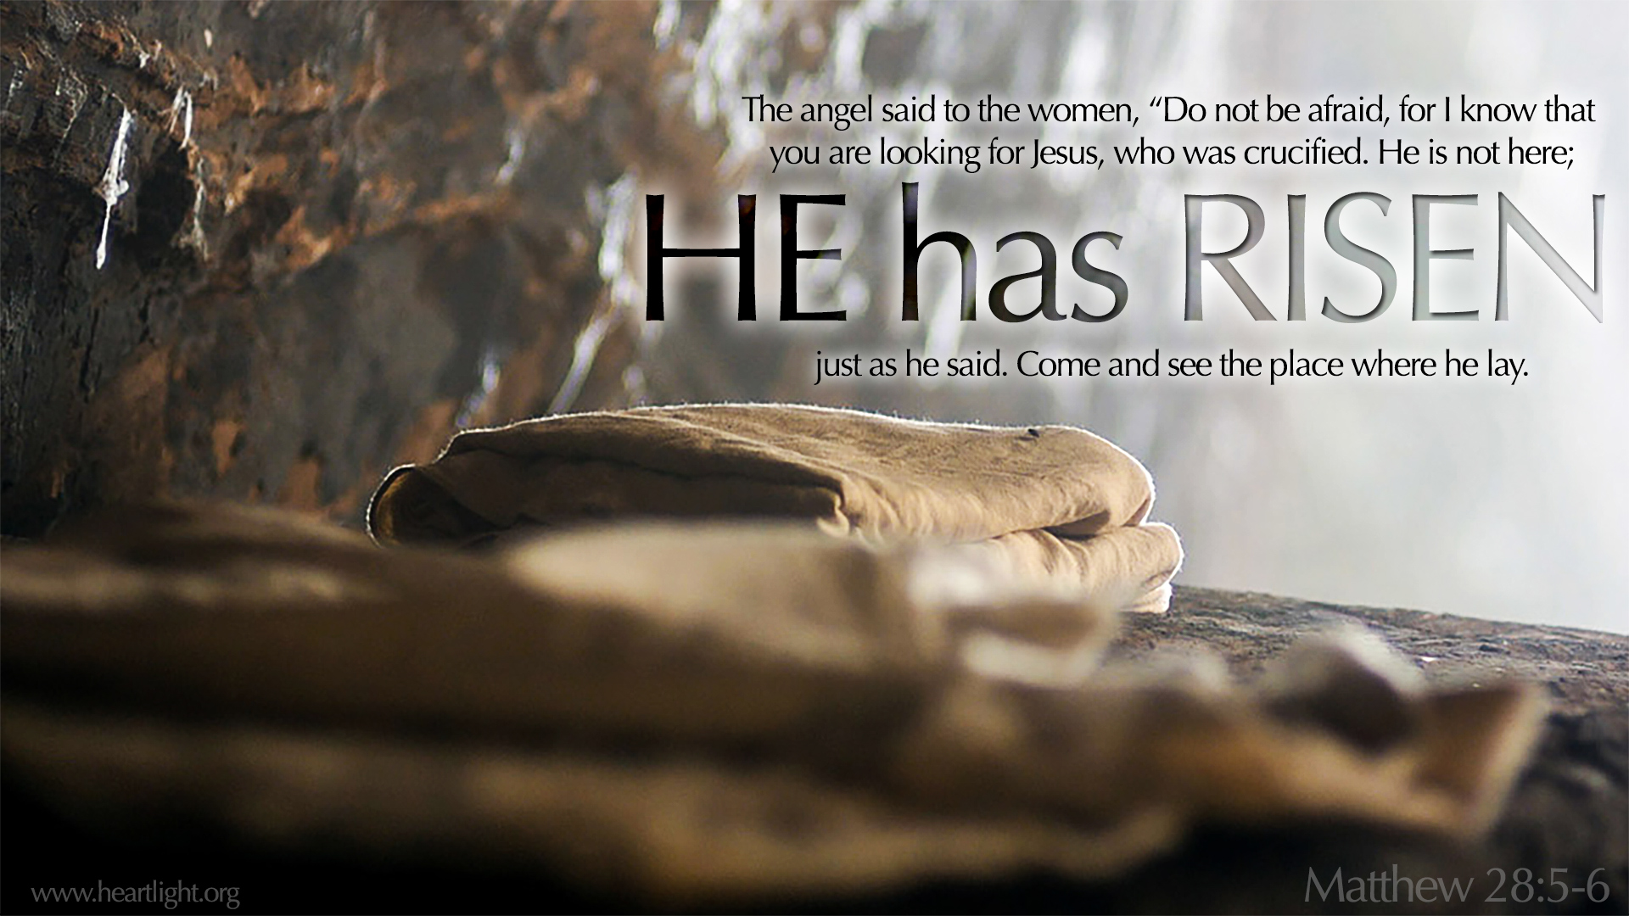
His Victorious Resurrection

Slide 2
His Victorious Resurrection
The Centrality of the Resurrection
  SIX serious issues [1 Corinthians 15]
The Certainty of the Resurrection
  GRAVE
  GROUPS of Witnesses
  GRACE of God
The Consequences of the Resurrection
  SATISFACTION
  SAINT

Slide 3
The Centrality of the Resurrection
1 Corinthians 15.3–5: For I delivered unto you first of all that which I also received, how that Christ died for our sins according to the scriptures; And that he was buried, and that he rose again the third day according to the scriptures: And that he was seen of Cephas, then of the twelve…

Slide 4
The Centrality of the Resurrection
1 Corinthians 15.13-18: But if there be no resurrection of the dead…
Then is Christ not risen:
Then is our preaching vain
And your faith is also vain
And we are found false witnesses of God
And if Christ be not raised, your faith is vain; ye are yet in your sins.
Then they also which are fallen asleep in Christ are perished.

Slide 5
The Certainty of the Resurrection
Grave. John 20.5–8: And he stooping down, and looking in, saw the linen clothes lying; yet went he not in.
6 Then cometh Simon Peter following him, and went into the sepulchre, and seeth the linen clothes lie, 7 And the napkin, that was about his head, not lying with the linen clothes, but wrapped together in a place by itself.
8 Then went in also that other disciple, which came first to the sepulchre, and he saw, and believed.

Slide 6
The Certainty of the Resurrection
Groups. Acts 1.3: To whom also he shewed himself alive after his passion by many infallible proofs, being seen of them forty days, and speaking of the things pertaining to the kingdom of God.
1 Corinthians 15.6, 8: After that, he was seen of above five hundred brethren at once; of whom the greater part remain unto this present, but some are fallen asleep… And last of all he was seen of me also, as of one born out of due time.

Slide 7
The Consequences of the Resurrection
Satisfaction. Acts 2.23-24: Him, being delivered by the determinate counsel and foreknowledge of God, ye have taken, and by wicked hands have crucified and slain: Whom God hath raised up, having loosed the pains of death: because it was not possible that he should be holden of it.
Acts 2.36: God hath made that same Jesus, whom ye have crucified, both Lord and Christ.

Slide 8
The Consequences of the Resurrection
Saint [RELIEF]
Hebrews 13.20-21: Now the God of peace, that brought again from the dead our Lord Jesus, that great shepherd of the sheep… make you perfect in every good work…

Slide 9
The Consequences of the Resurrection
Saint [RELATIONSHIP]
Romans 7.4: Ye also are become dead to the law by the body of Christ; that ye should be married to another, even to him who is raised from the dead, that we should bring forth fruit unto God.

Slide 10
The Consequences of the Resurrection
Distinctive. Romans 6.4: Like as Christ was raised up from the dead by the glory of the Father, even so we also should walk in newness of life.
Direction. 2 Corinthians 5.15: They which live should not henceforth live unto themselves, but unto him which died for them, and rose again.
Desires. Colossians 3.1: If ye then be risen with Christ, seek those things which are above, where Christ sitteth on the right hand of God.

