Slide 1
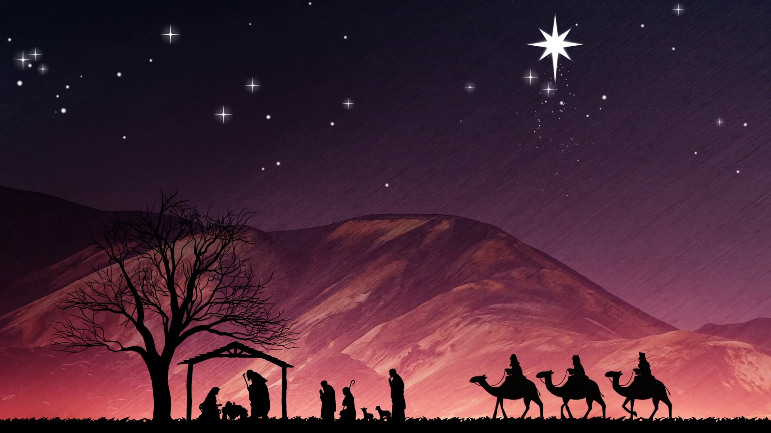
His Virgin Birth
Isaiah 7.14: Behold, a virgin shall conceive, and bear a son, And shall call his name Immanuel.

Slide 2
His Virgin Birth
Virgin Birth in Prophecy
Virgin Birth in History
Virgin Birth and Heresy
Virgin Birth – Its Necessity

Slide 3
Virgin Birth in PROPHECY
Genesis 3.15: And I will put enmity between thee [Serpent] and the woman, and between thy seed and her seed; it shall bruise thy head, and thou shalt bruise his heel [Calvary].
Isaiah 7.11: Ask thee a sign of the LORD thy God; Ask it either in the depth, or in the height above.
Isaiah 7.14: Therefore the Lord himself shall give you a sign; Behold, a virgin shall conceive, and bear a son, And shall call his name Immanuel.

Slide 4
Virgin Birth in PROPHECY
Matthew 1.22-23: Now all this was done, that it might be fulfilled which was spoken of the Lord by the prophet, saying, Behold, a virgin shall be with child, and shall bring forth a son, and they shall call his name Emmanuel, which being interpreted is, God with us.

Slide 5
Virgin Birth in HISTORY
WHAT? Luke 1.31: And, behold, thou shalt conceive in thy womb, and bring forth a son, and shalt call his name JESUS.
Luke 2.6–7: While they were there [Bethlehem], the days were accomplished that she should be delivered. And she brought forth her firstborn son, and wrapped him in swaddling clothes, and laid him in a manger; because there was no room for them in the inn.

Slide 6
Virgin Birth in HISTORY
HOW? Luke 1.31: And, behold, thou shalt conceive in thy womb, and bring forth a son, and shalt call his name JESUS.
Luke 1.35: And the angel answered and said unto her, The Holy Ghost shall come upon thee, and the power of the Highest shall overshadow thee: therefore also that holy thing which shall be born of thee shall be called the Son of God.

Slide 7
Virgin Birth in HISTORY
WHO? Luke 1.32: He shall be great, and shall be called the Son of the Highest: and the Lord God shall give unto him the throne of his father David.

Slide 8
Virgin Birth and HERESY
Immaculate Conception. Luke 1.47: And my spirit hath rejoiced in God my Saviour.
Perpetual Virginity. Matthew 1.25: And knew her not till she had brought forth her firstborn son: and he called his name JESUS.
Transubstantiation. Philippians 2.6–7: Who, being in the form of God… made himself of no reputation, and took upon him the form of a servant, and was made in the likeness of men.

Slide 9
Virgin Birth – Its NECESSITY
SALVATION. Hebrews 2.14: Forasmuch then as the children are partakers of flesh and blood, he also himself likewise took part of the same; that through death he might destroy him that had the power of death, that is, the devil.
Hebrews 9.22: Without shedding of blood is no remission.

Slide 10
Virgin Birth – Its NECESSITY
SOVEREIGN. Luke 1.32: He shall be great, and shall be called the Son of the Highest: and the Lord God shall give unto him the throne of his father David.
Jeremiah 22.30: Thus saith the LORD, Write ye this man childless, a man that shall not prosper in his days: for no man of his seed shall prosper, sitting upon the throne of David, and ruling any more in Judah.

Slide 11
Virgin Birth – Its NECESSITY
SOVEREIGN. Matthew 1.11: And Josias begat Jechonias and his brethren, about the time they were carried away to Babylon.
Matthew 1.16: And Jacob begat Joseph the husband of Mary, of whom [feminine] was born Jesus, who is called Christ.

Slide 12
Virgin Birth – Its NECESSITY
SUCCOUR. Hebrews 2.18: For in that he himself hath suffered being tempted, he is able to succour them that are tempted.
Hebrews 4.15: For we have not an high priest which cannot be touched with the feeling of our infirmities; but was in all points tempted like as we are, yet without sin.

