Slide 1

DISCIPLESHIP
Acts 11.26: And the disciples were called Christians first in Antioch

Slide 2
Discipleship
Constructing a Study
Character of True Disciples
Cost of True Discipleship
Comparison of Two Disciples

Slide 3
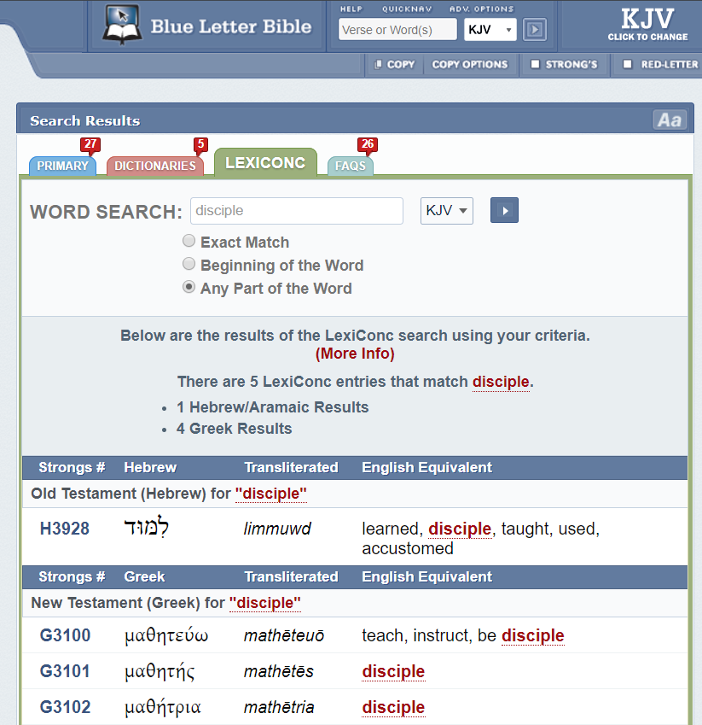
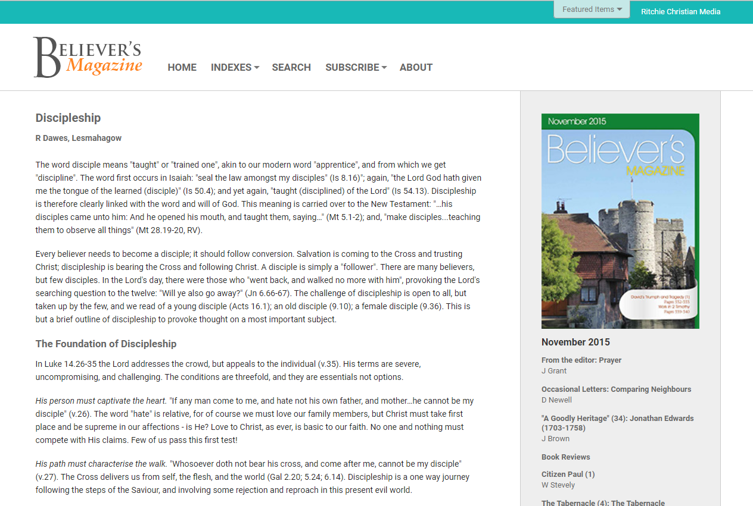

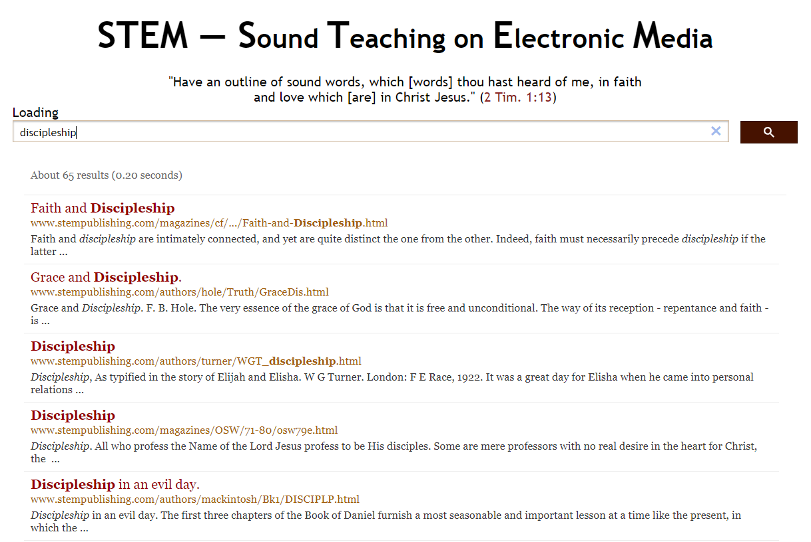
Constructing a Study

Slide 4
Constructing a Study
Luke 6.40: The disciple is not above his master: but every one that is perfect shall be as his master.
Isaiah 50.4: The Lord GOD hath given me the tongue of the learned (disciple)… He wakeneth mine ear to hear as the learned (disciple).
John 12.50: Whatsoever I speak… even as the Father said unto me, so I speak.

Slide 5
Constructing a Study
John 6.66: From that time many of his disciples went back (renounced), and walked no more with him.
Evan Hopkins: “The Saviour is not looking for men and women who will give their spare evenings to Him—or their weekends—or their years of retirement. Rather He seeks those who will give Him first place in their lives. He looks today, not for crowds drifting aimlessly in His track, but for individual men and women whose undying allegiance springs from an overflowing heart of affection for Him.”

Slide 6
Character of True Disciples
John 15.8: Herein is my Father glorified, that ye bear much fruit; so shall ye be my disciples.
John 15.5: I am the vine, ye are the branches: He that abideth in me, and I in him, the same bringeth forth much fruit: for without me ye can do nothing.
John 1.39: He saith unto them, Come and see. They came and saw where he dwelt, and abode with him that day: for it was about the tenth hour.

Slide 7
Character of True Disciples
John 13.34-35: A new commandment I give unto you, That ye love one another; as I have loved you, that ye also love one another. By this shall all men know that ye are my disciples, if ye have love one to another.
John 8.31: Then said Jesus to those Jews which believed on him, If ye continue (abide, persevere) in my word, then are ye my disciples indeed.

Slide 8
Cost of True Discipleship
Luke 9.23: And he said to them all, If any man will come after me, let him deny himself, and take up his cross daily, and follow me.
Hebrews 11.25-26: Choosing rather to suffer affliction with the people of God, than to enjoy the pleasures of sin for a season; Esteeming the reproach of Christ greater riches than the treasures in Egypt…

Slide 9
Cost of True Discipleship
Luke 14.26: If any man come to me, and hate not his father, and mother, and wife, and children, and brethren, and sisters, yea, and his own life also, he cannot be my disciple.
v.33: So likewise, whosoever he be of you that forsaketh not all that he hath, he cannot be my disciple.

Slide 10
Comparison of Two Disciples
1 Corinthians 10.12: Wherefore let him that thinketh he standeth take heed lest he fall.
Acts 21.16: There went with us also certain of the disciples of Caesarea, and brought with them one Mnason of Cyprus, an old disciple, with whom we should lodge.

