Slide 1
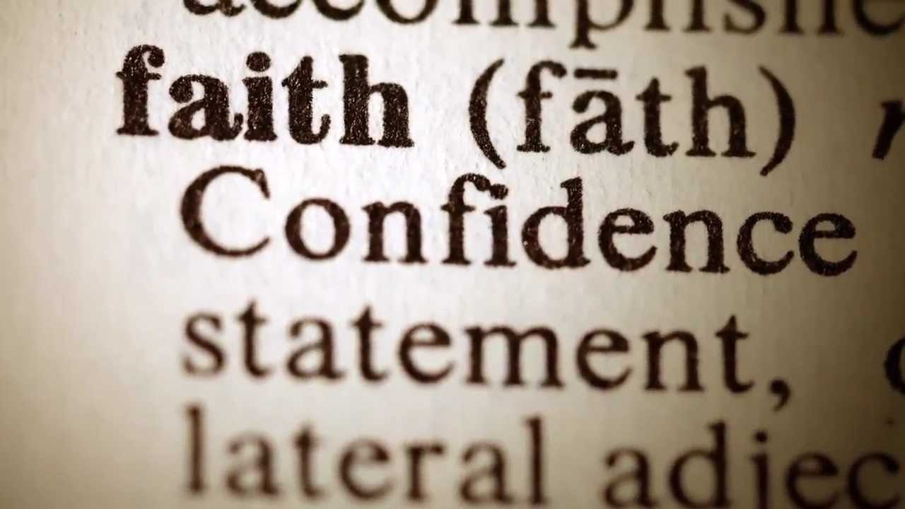
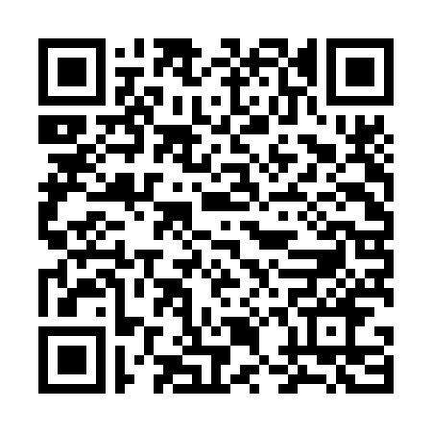
MAN’S RESPONSIBILITY
Acts 4.4: Many of them which heard the word believed…

Slide 2
Man’s Responsibility
The Preaching of the Apostles
The Presentation of Responsibility
The Promise of Blessing
The Proof of Genuine Faith

Slide 3
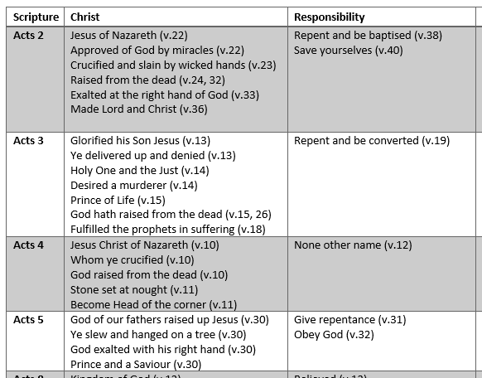
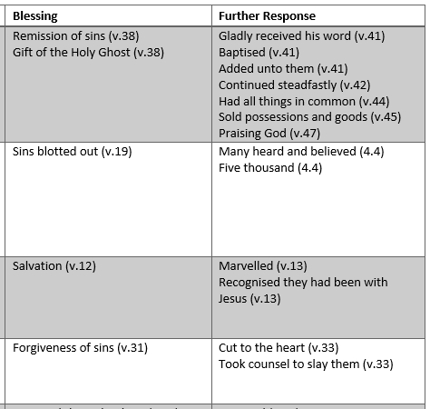
The Preaching of the Apostles

Slide 4
Presentation of Responsibility
Acts 3.19: Repent… and be converted, that your sins may be blotted out.
Acts 26.20: That they should repent and turn to God, and do works meet for repentance.
Isaiah 55.7: Let the wicked forsake his way, And the unrighteous man his thoughts: And let him return unto the LORD, and he will have mercy upon him…

Slide 5
Presentation of Responsibility
Acts 16.31: Believe on the Lord Jesus Christ, and thou shalt be saved, and thy house.
John 3.36: He that believeth on (eis) the Son hath everlasting life…
Romans 5.1: Therefore being justified by faith, we have peace with God through our Lord Jesus Christ.
James 2.19: Thou believest that there is one God; thou doest well: the devils also believe, and tremble.

Slide 6
The Presentation of Responsibility
Saving faith = conviction, confidence (in a risen Christ) and conduct.
David Newell: “Faith is not a leap in the dark but a conscious step into the light of God’s revealed word. Indeed, it is the most rational thing in the world to put your confidence in the only person in the universe who cannot lie.”

Slide 7
The Promise of Blessing
Acts 2.38: Repent, and be baptized every one of you in the name of Jesus Christ for the remission of sins…
Acts 3.19: Repent ye therefore, and be converted, that your sins may be blotted out.
Acts 13.39: And by him all that believe are justified from all things, from which ye could not be justified by the law of Moses.

Slide 8
The Proof of Genuine Faith
James 2.17: Faith, if it hath not works, is dead, being alone.
Matthew 3.8: Produce fruit that proves your repentance. NET
Acts 2.41: Then they that gladly received his word were baptized: and the same day there were added unto them about three thousand souls.
Acts 2.42: And they continued stedfastly in the apostles’ doctrine and fellowship, and in breaking of bread, and in prayers.

Slide 9
The Proof of Genuine Faith
Romans 10.9: If you confess with your mouth that Jesus is the Lord and believe in your heart that God raised him from the dead, you will be saved. NET
Acts 9.5-6: And he said, Who art thou, Lord? And the Lord said, I am Jesus… And he trembling and astonished said, Lord, what wilt thou have me to do?
1 Peter 3.15: Set Christ apart as Lord in your hearts.

