Slide 1

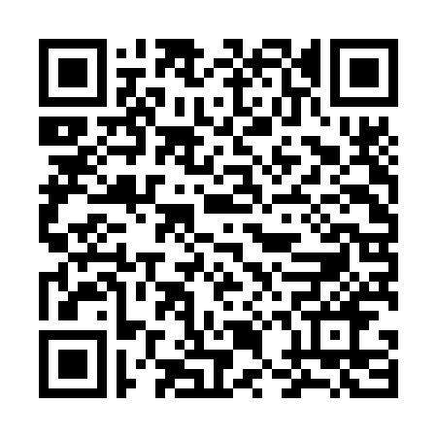
MAN’S RUIN
Rom. 3.23: All have sinned…

Slide 2
Man’s Ruin
The Cause of Sin
The Character of Sin
The Comparison of Sin and Sins
The Consequences of Sin
The Christian and Sin

Slide 3
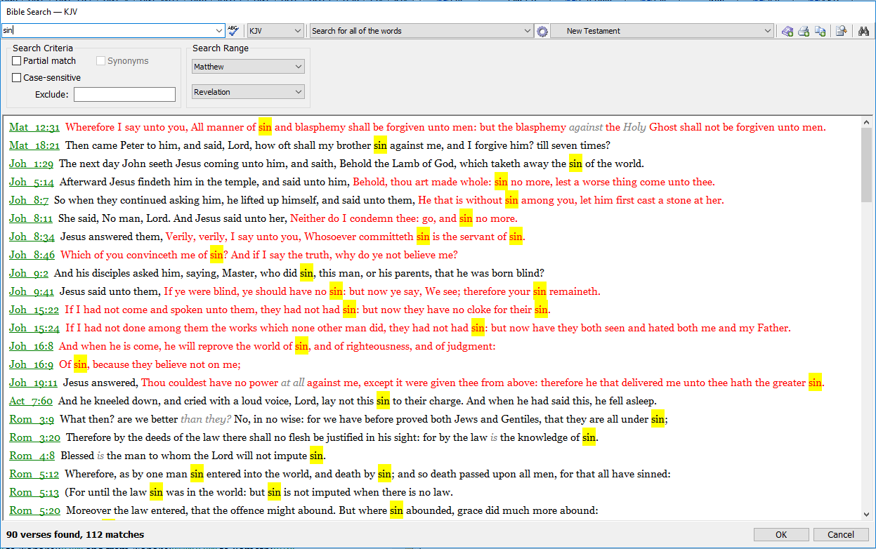
Studying the Subject
Concordance

Slide 4
Studying the Subject
Concordance
Analyse references…

Slide 5
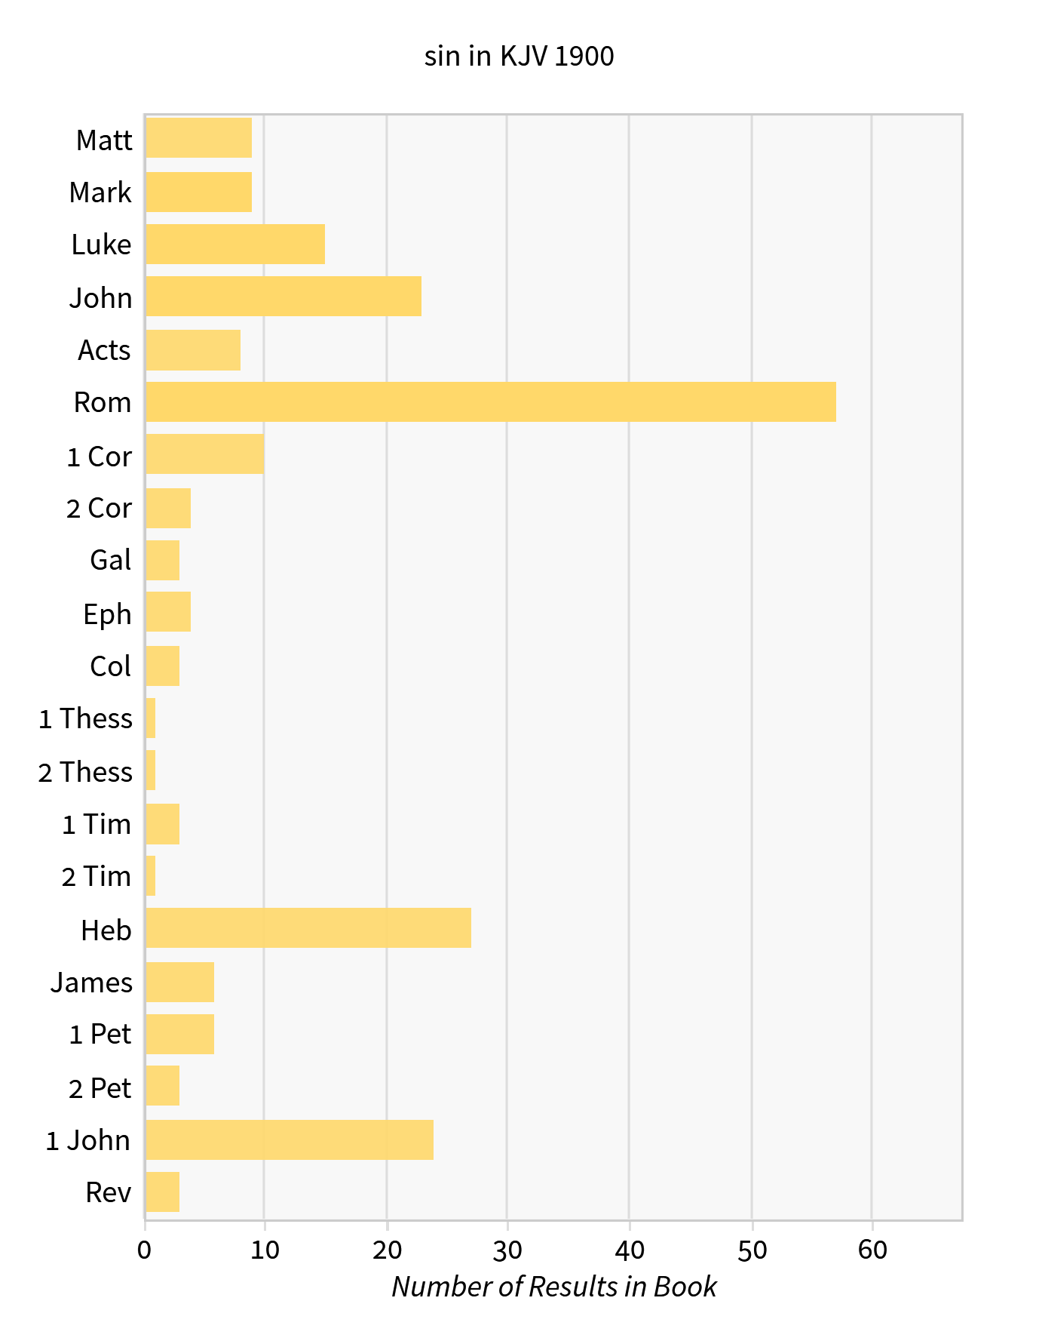
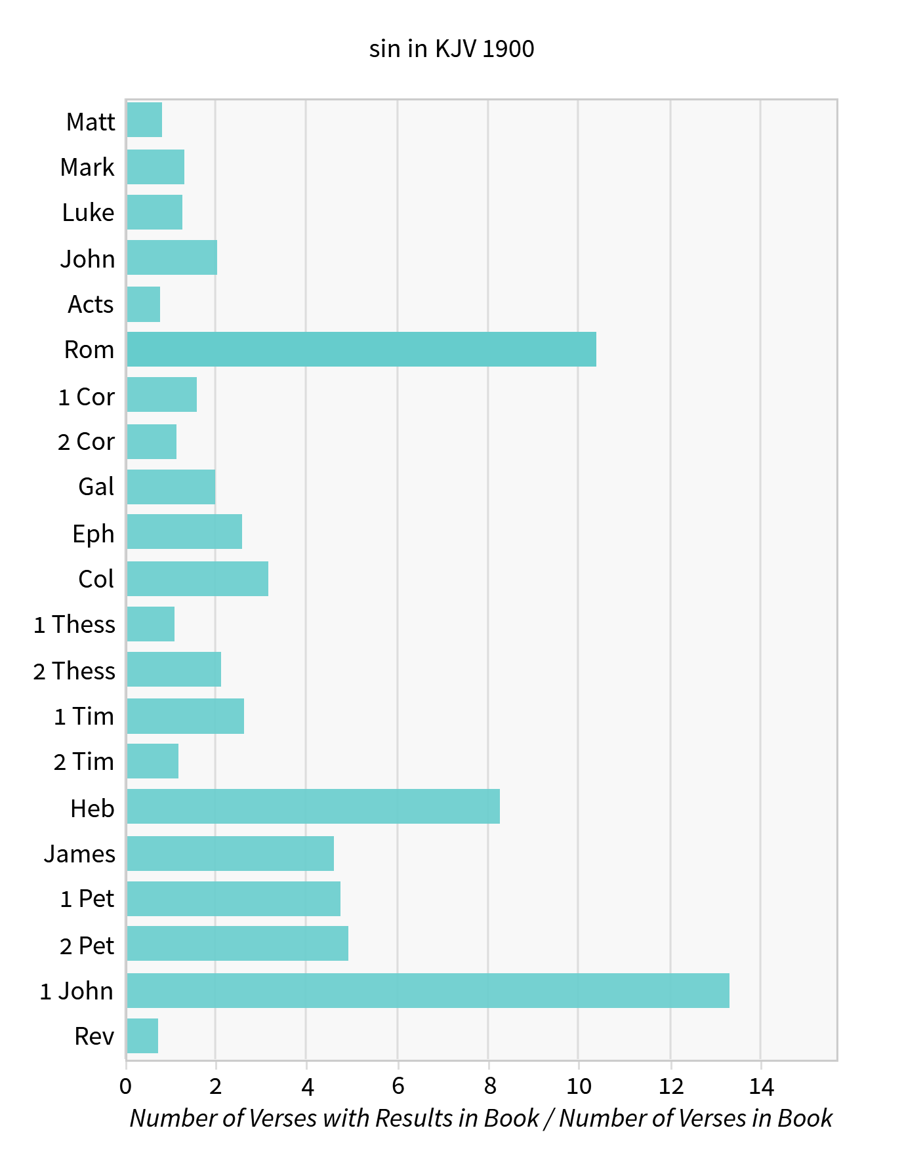
Studying the Subject

Slide 6
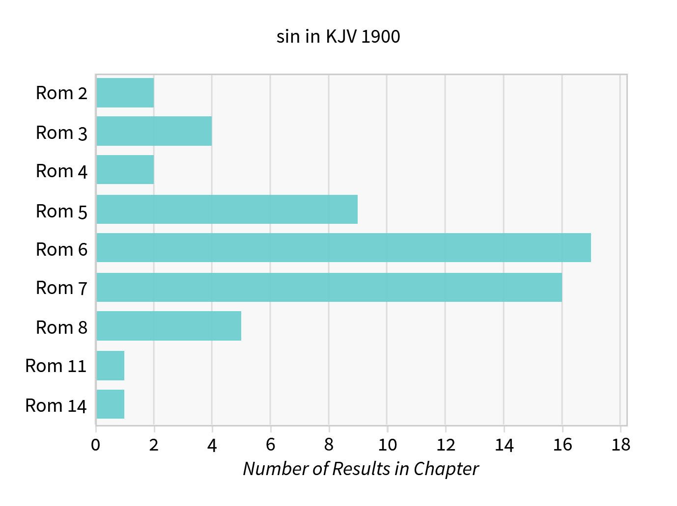

Slide 7
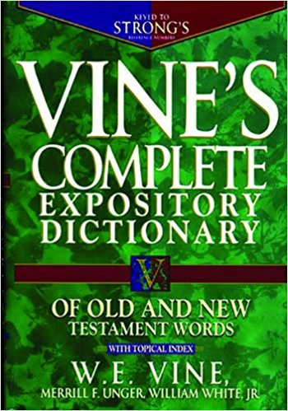
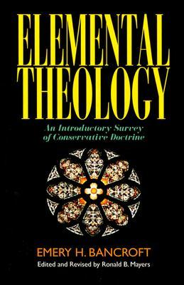

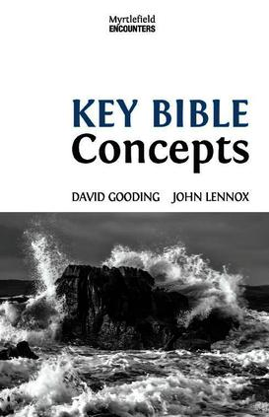
Studying the Subject
Concordance
Analyse references…
Ask simple questions
Categorise some references…
Use helps

Slide 8
The Cause of Sin
Ezekiel 28.15: Thou wast perfect in thy ways from the day that thou wast created, till iniquity was found in thee.
Isaiah 14.12–14: How art thou fallen from heaven, O Lucifer, son of the morning! For thou hast said in thine heart, I will ascend into heaven, I will exalt my throne above the stars of God… I will ascend above the heights of the clouds; I will be like the most High.

Slide 9
The Cause of Sin
Ecclesiastes 7.29: God hath made man upright (righteous, just).
Genesis 3.1: Hath God said (DOUBT), ye shall not eat of every (DISTORT) tree of the garden?
Genesis 3.4: Ye shall not surely die (DENY).

Slide 10
The Character of Sin
harmartia (sin) = to miss the mark
parabasis (transgression)
parakoe (disobedience) = failing to hear
James 4.17: To him that knoweth to do good, and doeth it not, to him it is sin.
Romans 14.23: Whatsoever is not of faith is sin.

Slide 11
Comparing Sin and Sins
Romans 5.12: Wherefore, as by one man (Adam) sin entered into the world, and death by sin; and so death passed upon all men, for that all have sinned.
Sin = evil principle (poison, power)
Sins = individual, personal sins

Slide 12
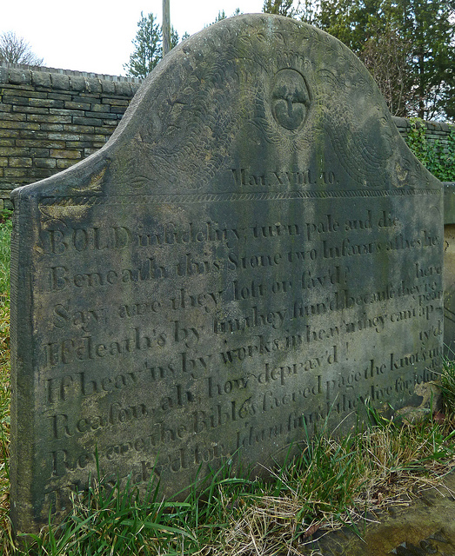
The Consequences of Sin
Death…

Slide 13
The Consequences of Sins
Romans 3.19: That every mouth may be stopped, and all the world may become guilty before God.
Isaiah 59:2: Your iniquities have separated between you and your God.
Revelation 20.12: And I saw the dead, small and great, stand before God… and the dead were judged…

Slide 14
The Christian and Sin
1 Peter 2.11: Abstain from fleshly lusts, which war against the soul.
Psalm 119.11: Thy word have I hid in mine heart, That I might not sin against thee.
Romans 8.13: Through the Spirit… mortify the deeds of the body.
1 John 2.1: If any man sin, we have an advocate with the Father, Jesus Christ the righteous.

