Slide 1
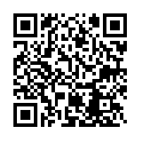

How can I study my Bible?
Practical ways in which to get to grips with Bible study
https://www.dropbox.com/sh/l6kur01d2yoeur3/AAC8xA6b-xXiVerG4R7JrErca?dl=0

Slide 2

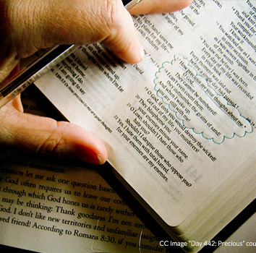

‘Our God is economical with miracles. Having made man in his image, having provided a perfect instruction book through supernatural inspiration, and having given us the best of all teachers in the Holy Spirit, He will work no fourth miracle to transfer truth from the scriptures into our minds. In other words, there is no short-cut to spirituality! Only through the solid and systematic study of God’s Word will the young believer grow in the knowledge of God, and thus be able to stand against the storms of the world, the flesh and the devil. And that means hard work.’ Newell
These were more fair- minded than those in Thessalonica, in that they received the word with all readiness, and searched the Scriptures daily to find out whether these things were so.
Therefore many of them believed, and also not a few of the Greeks, prominent women as well as men.
Acts 17:11,12

Slide 3


What do we mean by Bible study?
From childhood you have known the Holy Scriptures, which are able to make you wise for salvation through faith which is in Christ Jesus. All Scripture is given by inspiration of God, and is profitable for doctrine, for reproof, for correction, for instruction in righteousness, that the man of God may be complete, thoroughly equipped for every good work. 2 Timothy 3:14
We are not talking about Bible reading – a daily, set aside activity, accompanied by prayer
We are talking about more detailed reading, more careful reading – meditation and digging deeper into the Word of God
Having seen the reasons why the Word of God is so precious and why we ought to study it, we now need to try and get to grips with how
This is not something that should be reserved for the few – it is not just for preachers, teachers or leaders – every one of us, male and female should give time to the study of the Word of God
Neither is this an age thing – the more we can get to grips with it in our youth, the more things will remain in our minds
So, we have answered why, what about some of the other questions that help us with the how?

Slide 4
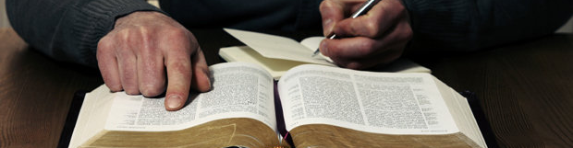
Where?
…when you pray, go into your room, and when you have shut your door, pray to your Father who is in the secret place
Matthew 6:6
In a quiet place
Free from interruptions and distractions
Where you feel comfortable
Somewhere you can study easily and readily with access to the resources you need

Slide 5

When?
For all the Athenians and the foreigners who were there spent their time in nothing else but either to tell or to hear some new thing
Acts 17:21
At a regular time – weekly or more often if possible
When you have set aside a decent amount of time
When others know that you need some time
When you haven’t really got time – because you never will have!

Slide 6

Who?
When Aquila and Priscilla heard him, they took him aside and explained to him the way of God more accurately
Acts 18:26
Certainly you will often need to be alone – there is really no substitute for this
You may have a particular study aid or Bible reading notes that are a helpful companion – though don’t completely rely on this – there is no substitute for your own thoughts and ideas
You may find it helpful to be with others
  Your spouse
  A good friend
  Others who are keen to study the Word of God together – it can help to create a discipline
  With other believers when the local church comes together

Slide 7
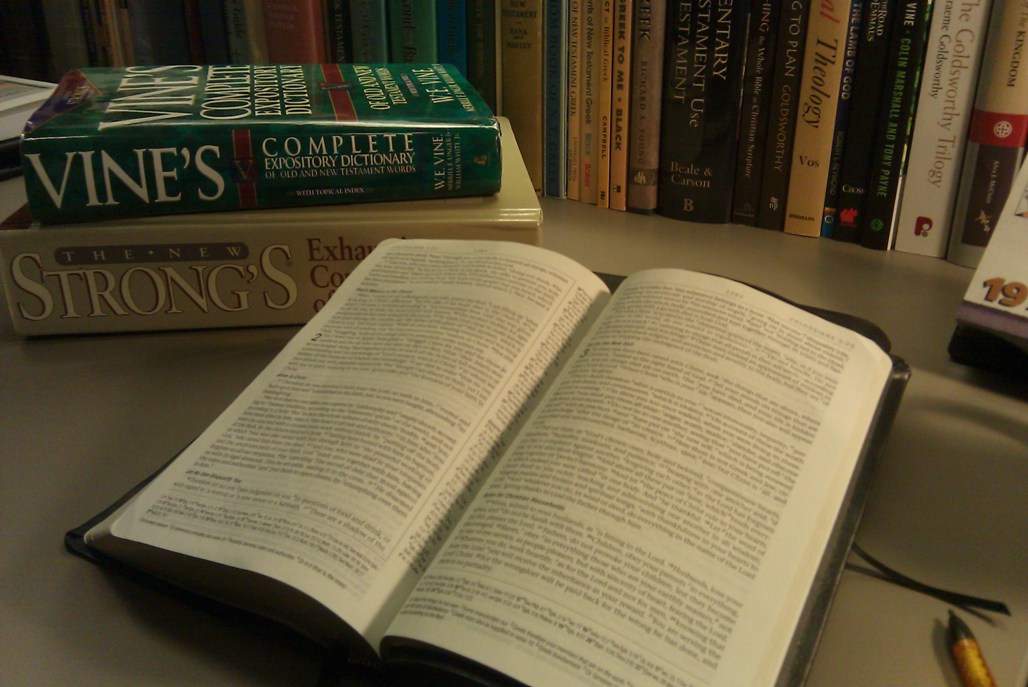
What?
Bring the cloak … when you come - and the books, especially the parchments.
2 Timothy 4:13
A good translation of the Bible – AV, NKJV are the best place to start – literal translations rather than dynamic equivalence are best
A concordance
A dictionary of biblical words
A wider Bible dictionary
An online / computer-based Bible resource
A notebook and pen (or maybe a tablet!)
A good filing system
There will be a number of key resources that will be useful to you – we will list a few here and then begin to unpick these now (much more later)

Slide 8

How?
There are a number of different ways in which to get down to the study of the Bible
Let’s look at some of them

Slide 9
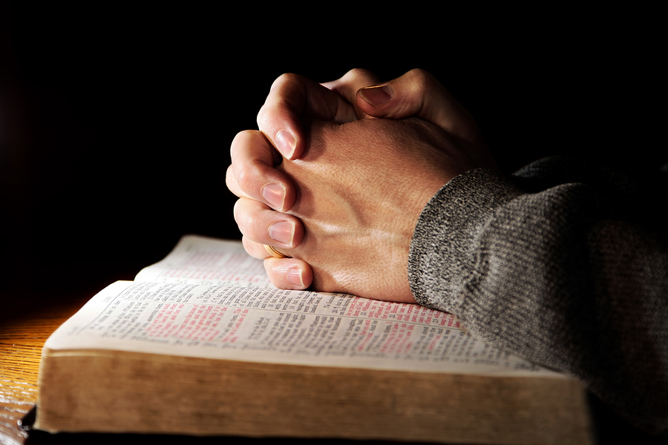
How?
And He opened their understanding, that they might comprehend the Scriptures Luke 24:45
Preparation
Pray for help, understanding and wisdom as you open the scriptures
Read
Read again
Read again
Read extended sections – even whole books
Read them again!
Meditate quietly, thoughtfully and prayerfully for a time
Make brief outline notes
Get familiar with the themes, outlines and general ideas of the passage
Create your own outline of a book or a chapter

Slide 10

How?
Going further
Pray and read again!
Start to make more detailed notes within your outline – these could be handwritten or on the computer / tablet
Unpick the sense of the verses – making notes all the time
What practical lessons can you learn from the passage? What will you need to do / change when you apply this to your life?
What can you learn about the Lord Jesus or about God himself? It may be direct teaching or there may be types and pictures
If you were to share what you had learnt with someone else, what would you say?
What unanswered questions do you still have?
Pray some more … are there any verses you could memorise?

Slide 11


How?
…some things hard to understand, which untaught and unstable people twist to their own destruction, as they do also the rest of the Scriptures.
You therefore, beloved, since you know this beforehand, beware lest you also fall from your own steadfastness, being led away with the error of the wicked; but grow in the grace and knowledge of our Lord and Saviour Jesus Christ 2 Peter 3:16
Digging deeper
Use the margin to find references to other helpful scriptures – the Treasury of Scripture Knowledge may help with this too – the Bible is the best commentary on the Bible! What other verses do you already know?
Are there some words that you think might be interesting to explore further? Reach for a dictionary of Old or New Testament words - Vine’s is hard to beat, or use the back of a concordance – Strong’s
Are there some places or people that are worth finding out more about? Search for them online or in a Bible Dictionary
Try to find some answers to your unanswered questions – consult a commentator or do some other research BUT be careful what you read – Google may throw up all sorts of weird and wonderful ideas; check out the publishers and authors of any commentaries you might use – are they reliable and trustworthy? Read critically and always test what is being said against the truth of the scriptures. MORE OF THIS LATER!
Talk to others who have wisdom and understanding to guide you
Keep it simple … and don’t forget to pray!

Slide 12
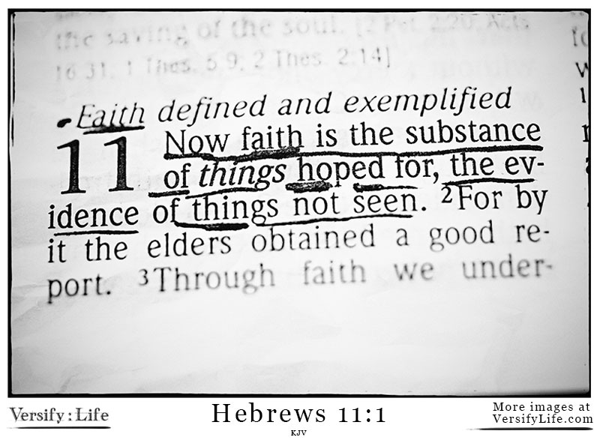
How?
Character study
Identify an interesting character through your daily Bible reading
Follow through the story of this person – as before, read it and read it – you may need to trace them through various books
Ask yourself some key questions about the character
  What are the main events?
  What challenges did they face?
  How did they overcome them?
  How does their life compare with yours?
  What practical lessons can you learn?
Move on to a connected character
IDEA: start in Hebrews 11 and follow through a series of character studies over the course of a year; or what about studies into each of the sons of Jacob starting from Genesis 49?
Going through chapter by chapter and verse by verse is really the best way to get to grips with Bible study
BUT there are other ways
Try some of these…
And all these, having obtained a good testimony through faith, did not receive the promise, God having provided something better for us. Hebrews 11:39

Slide 13
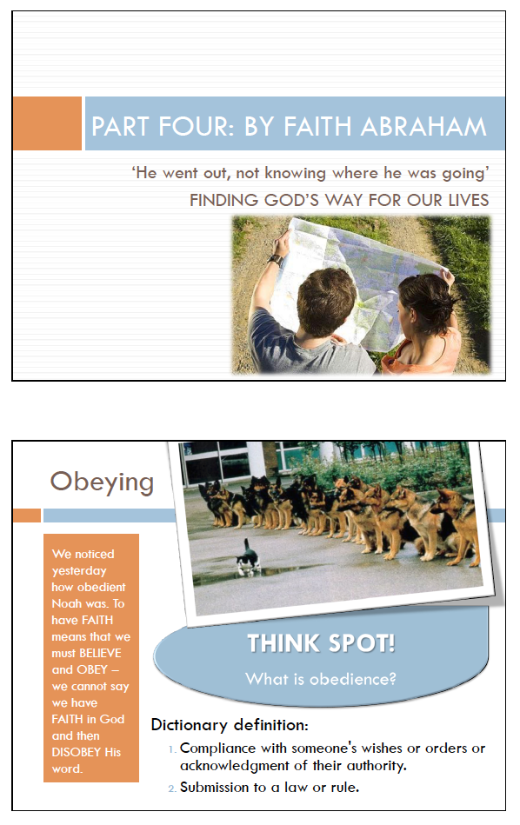
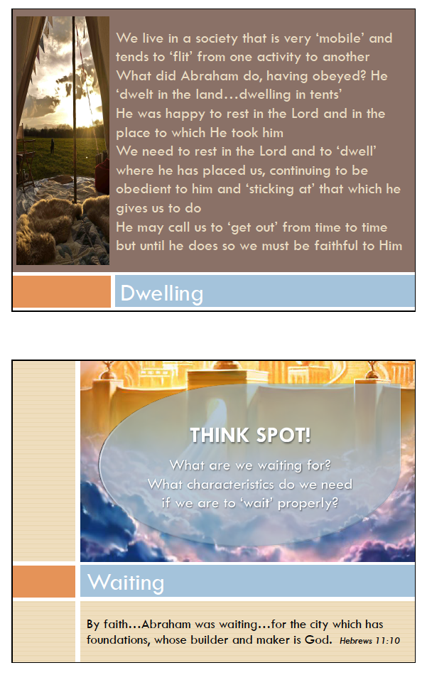
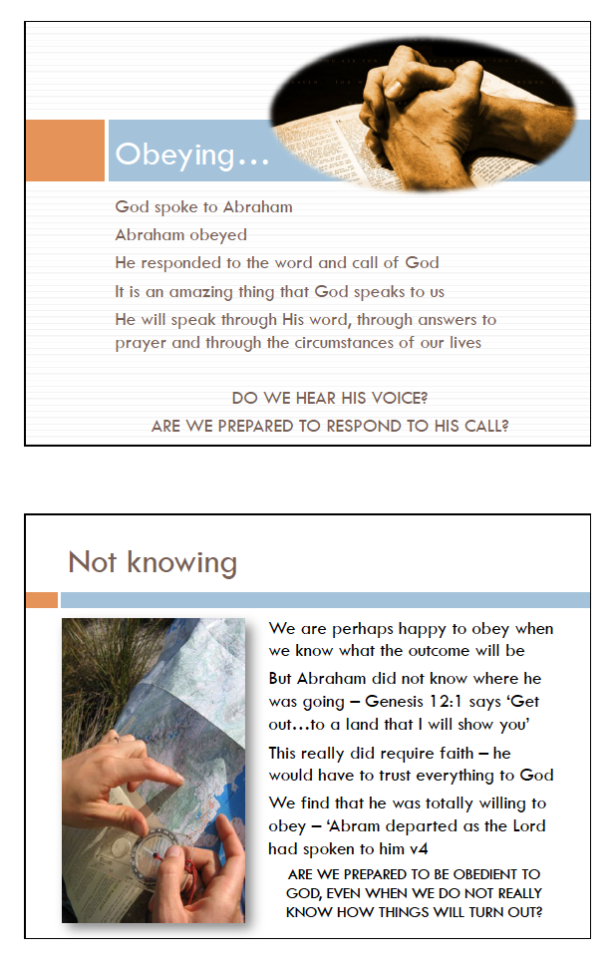
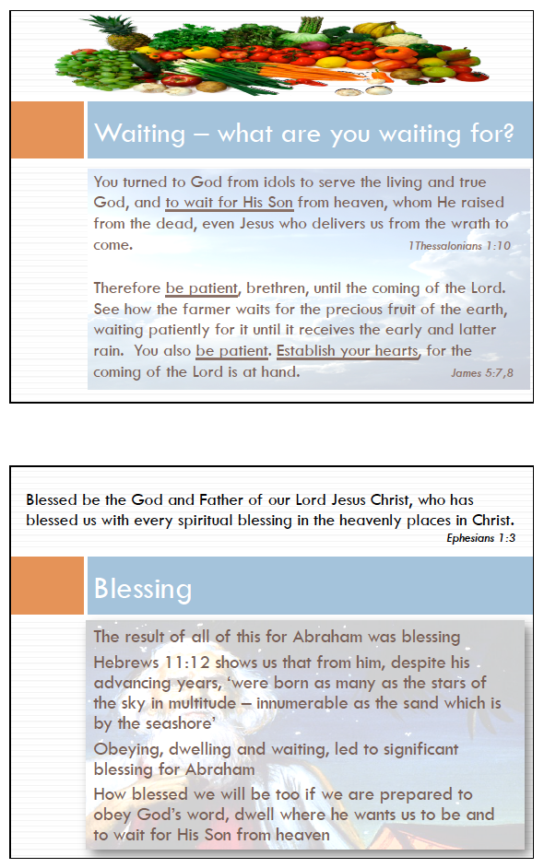
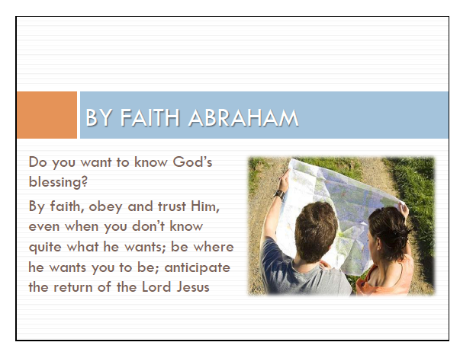

Slide 14
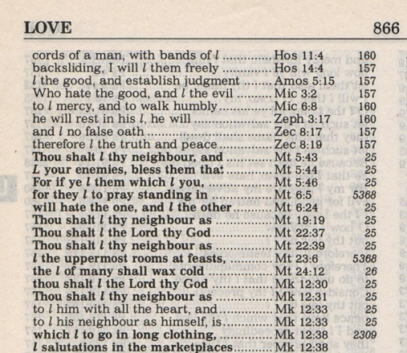
How?
Word study
In your daily Bible reading or further study, you may come across a word that is interesting
Use a concordance to find other references to that word
Are these actually all the same word in the original?
Follow through some of the key references to that word
What lessons can you take from the different references to that word
IDEA: Follow through references to the word ‘BEWARE’ to carry out a study of some of the key warnings of scripture; what about ‘RIGHTEOUSNESS’ or ‘SATISFIED’?
Going through chapter by chapter and verse by verse is really the best way to get to grips with Bible study
BUT there are other ways
Try some of these…
Every word of God is pure;
Proverbs 30:5

Slide 15
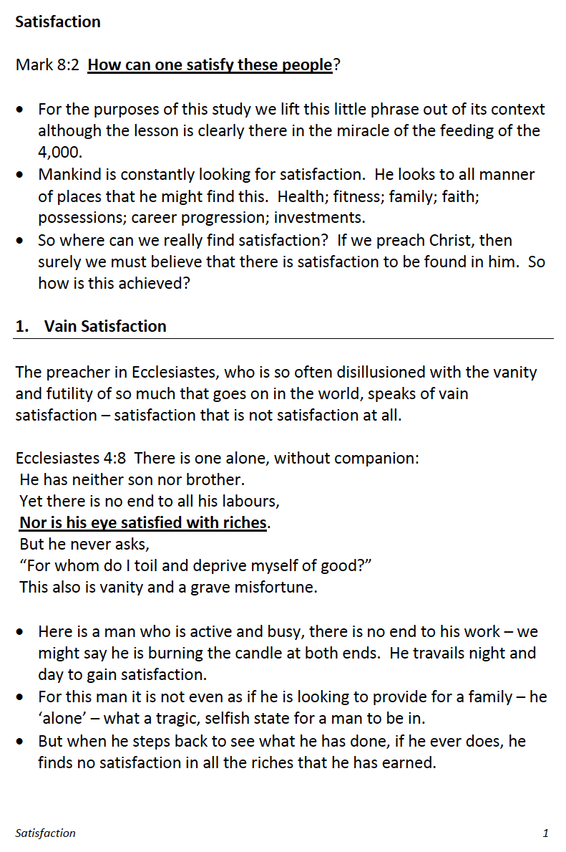
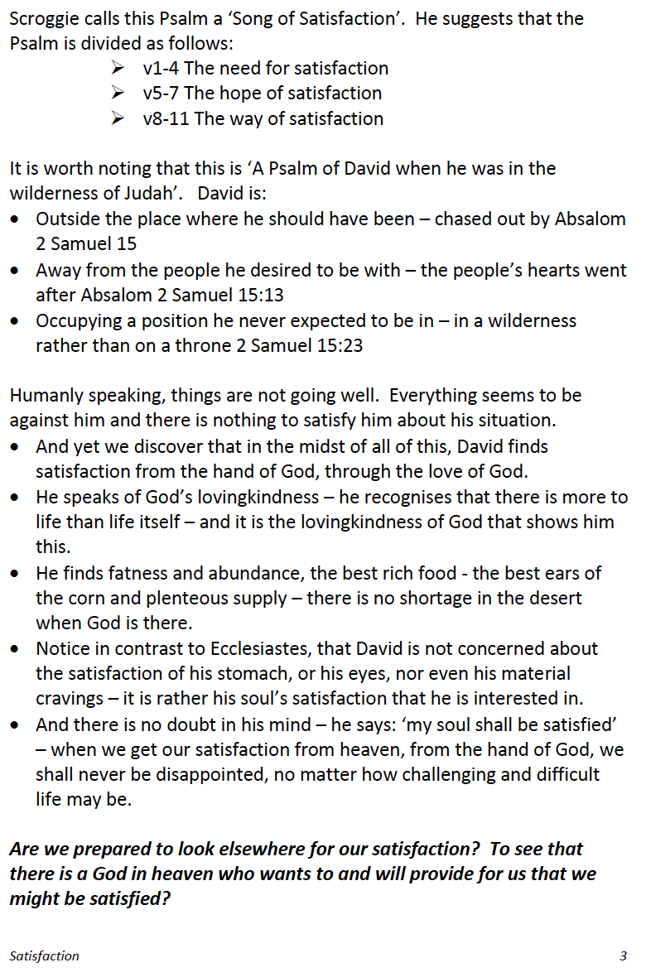
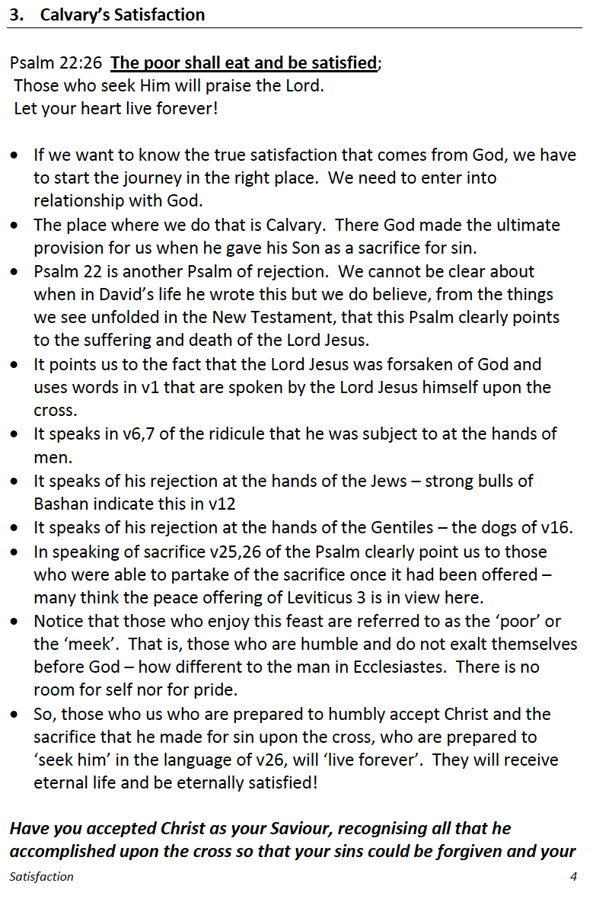
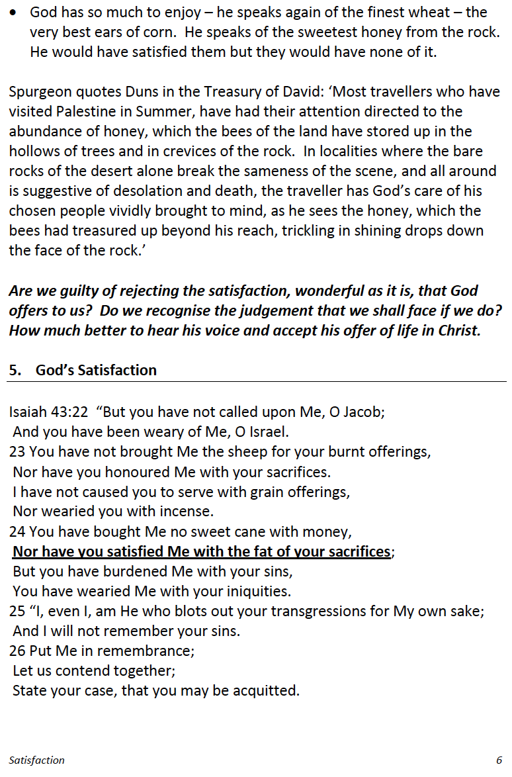
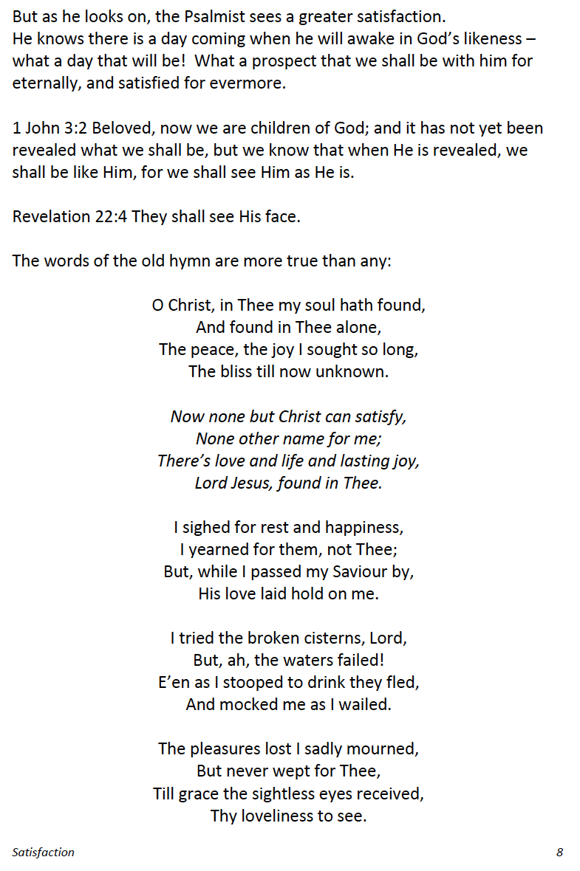
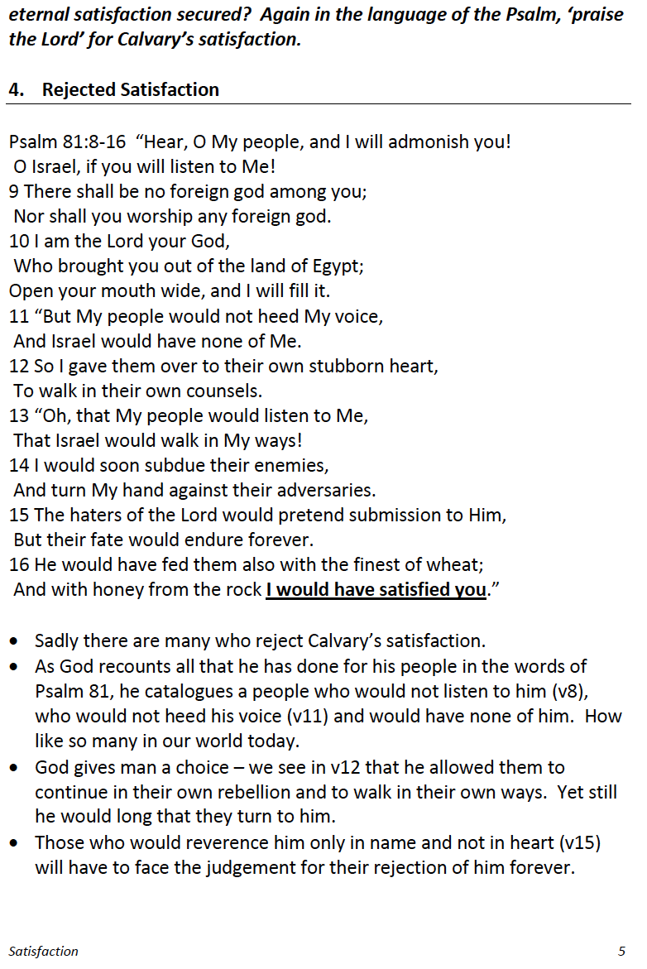
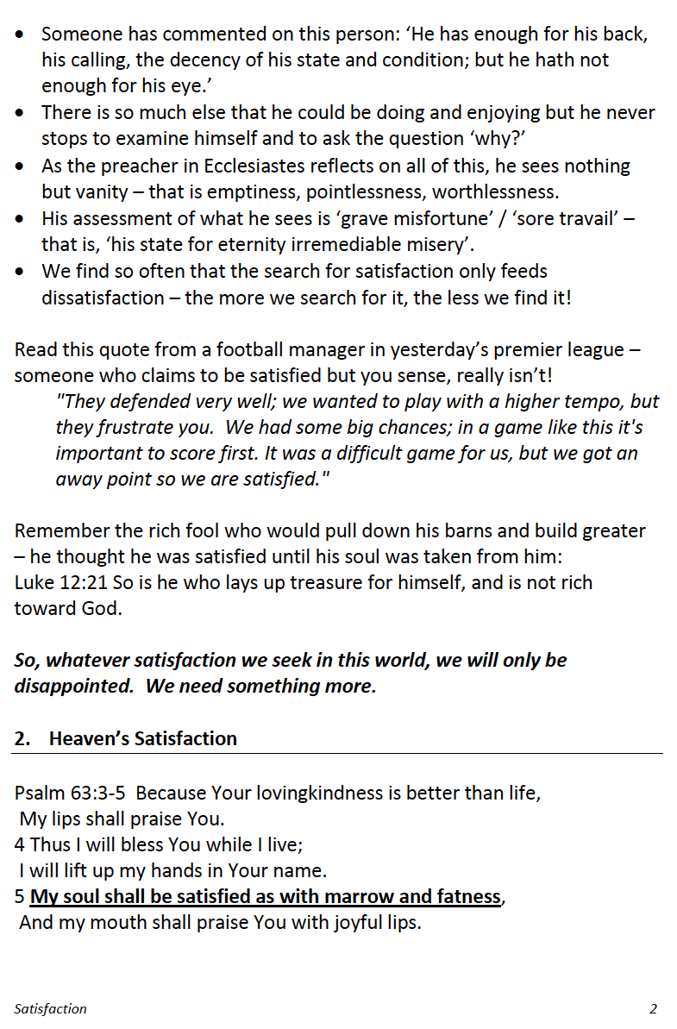
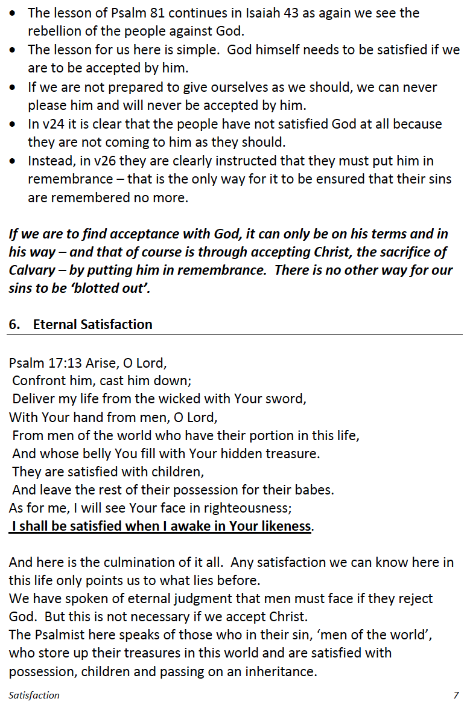

Slide 16
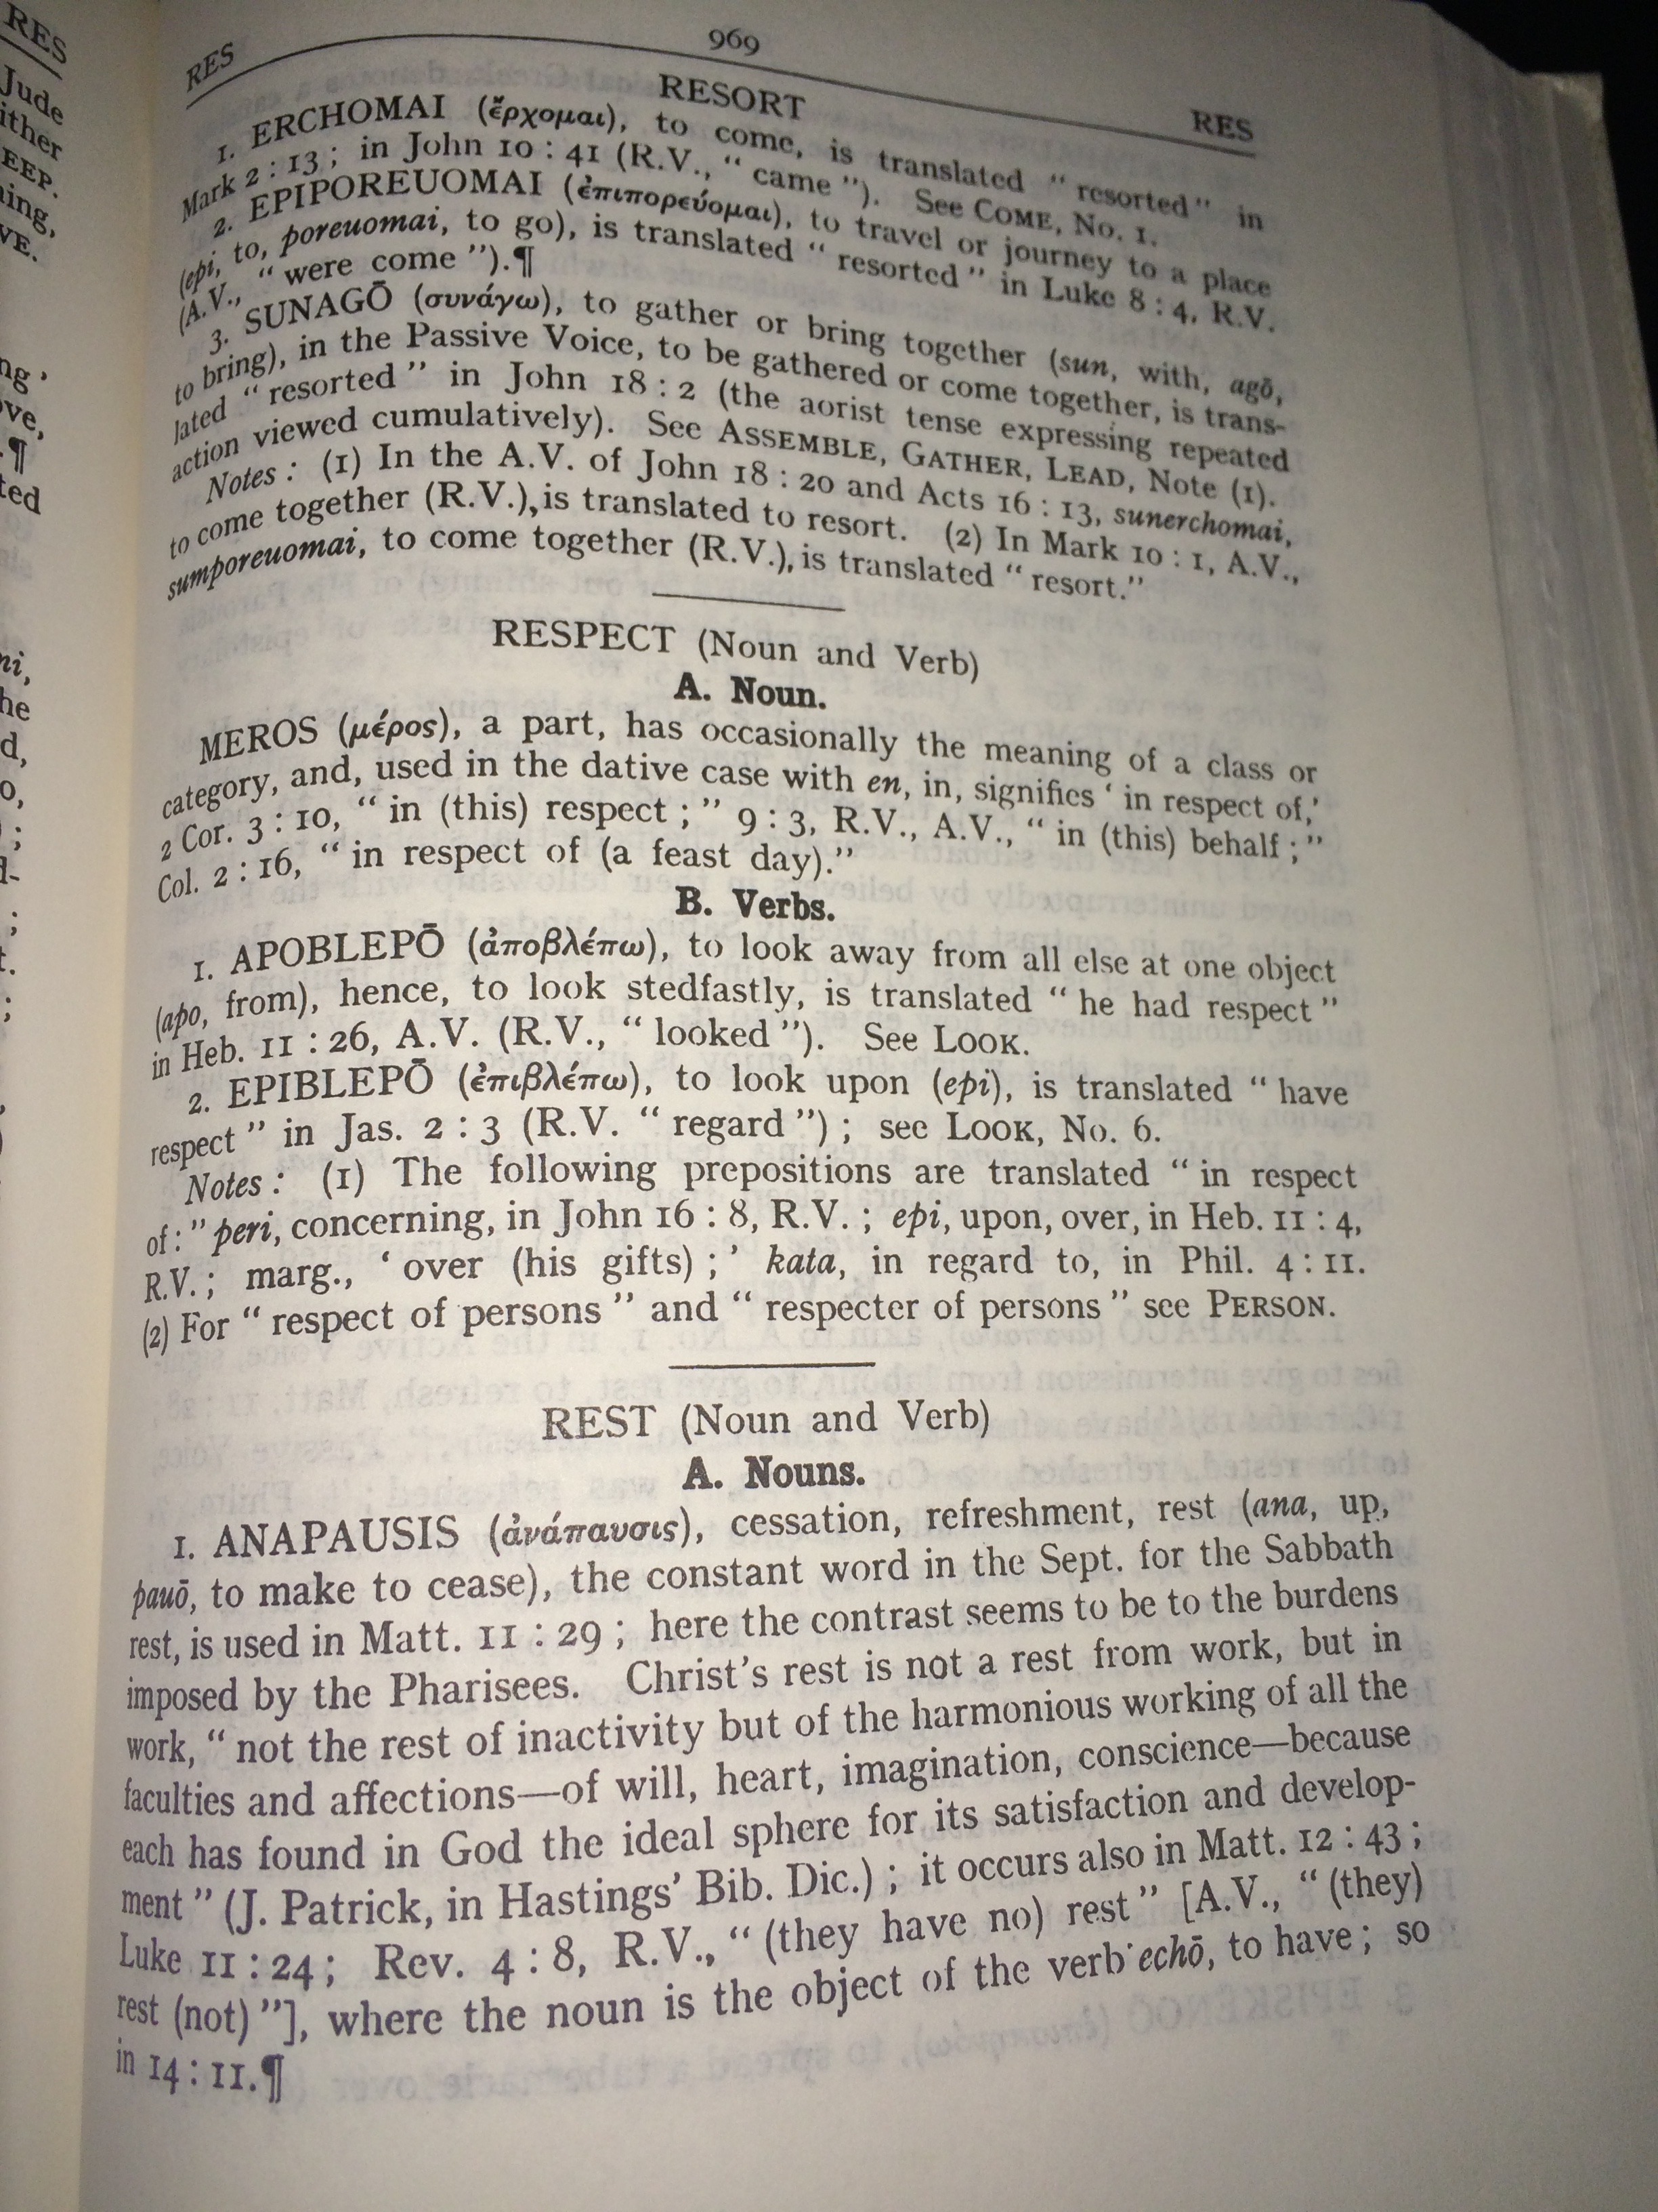
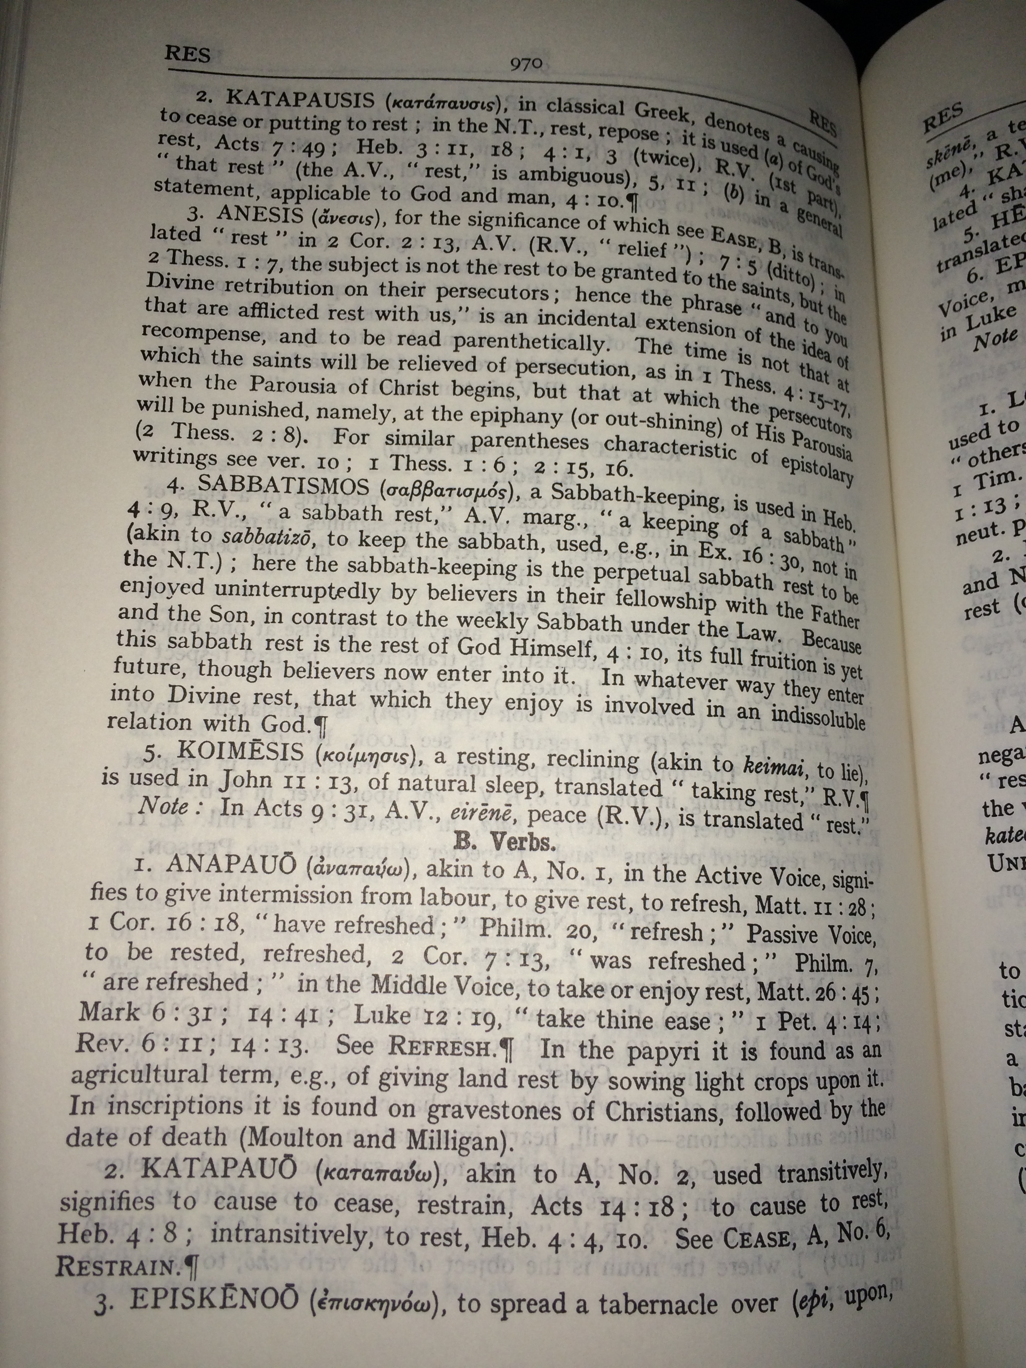
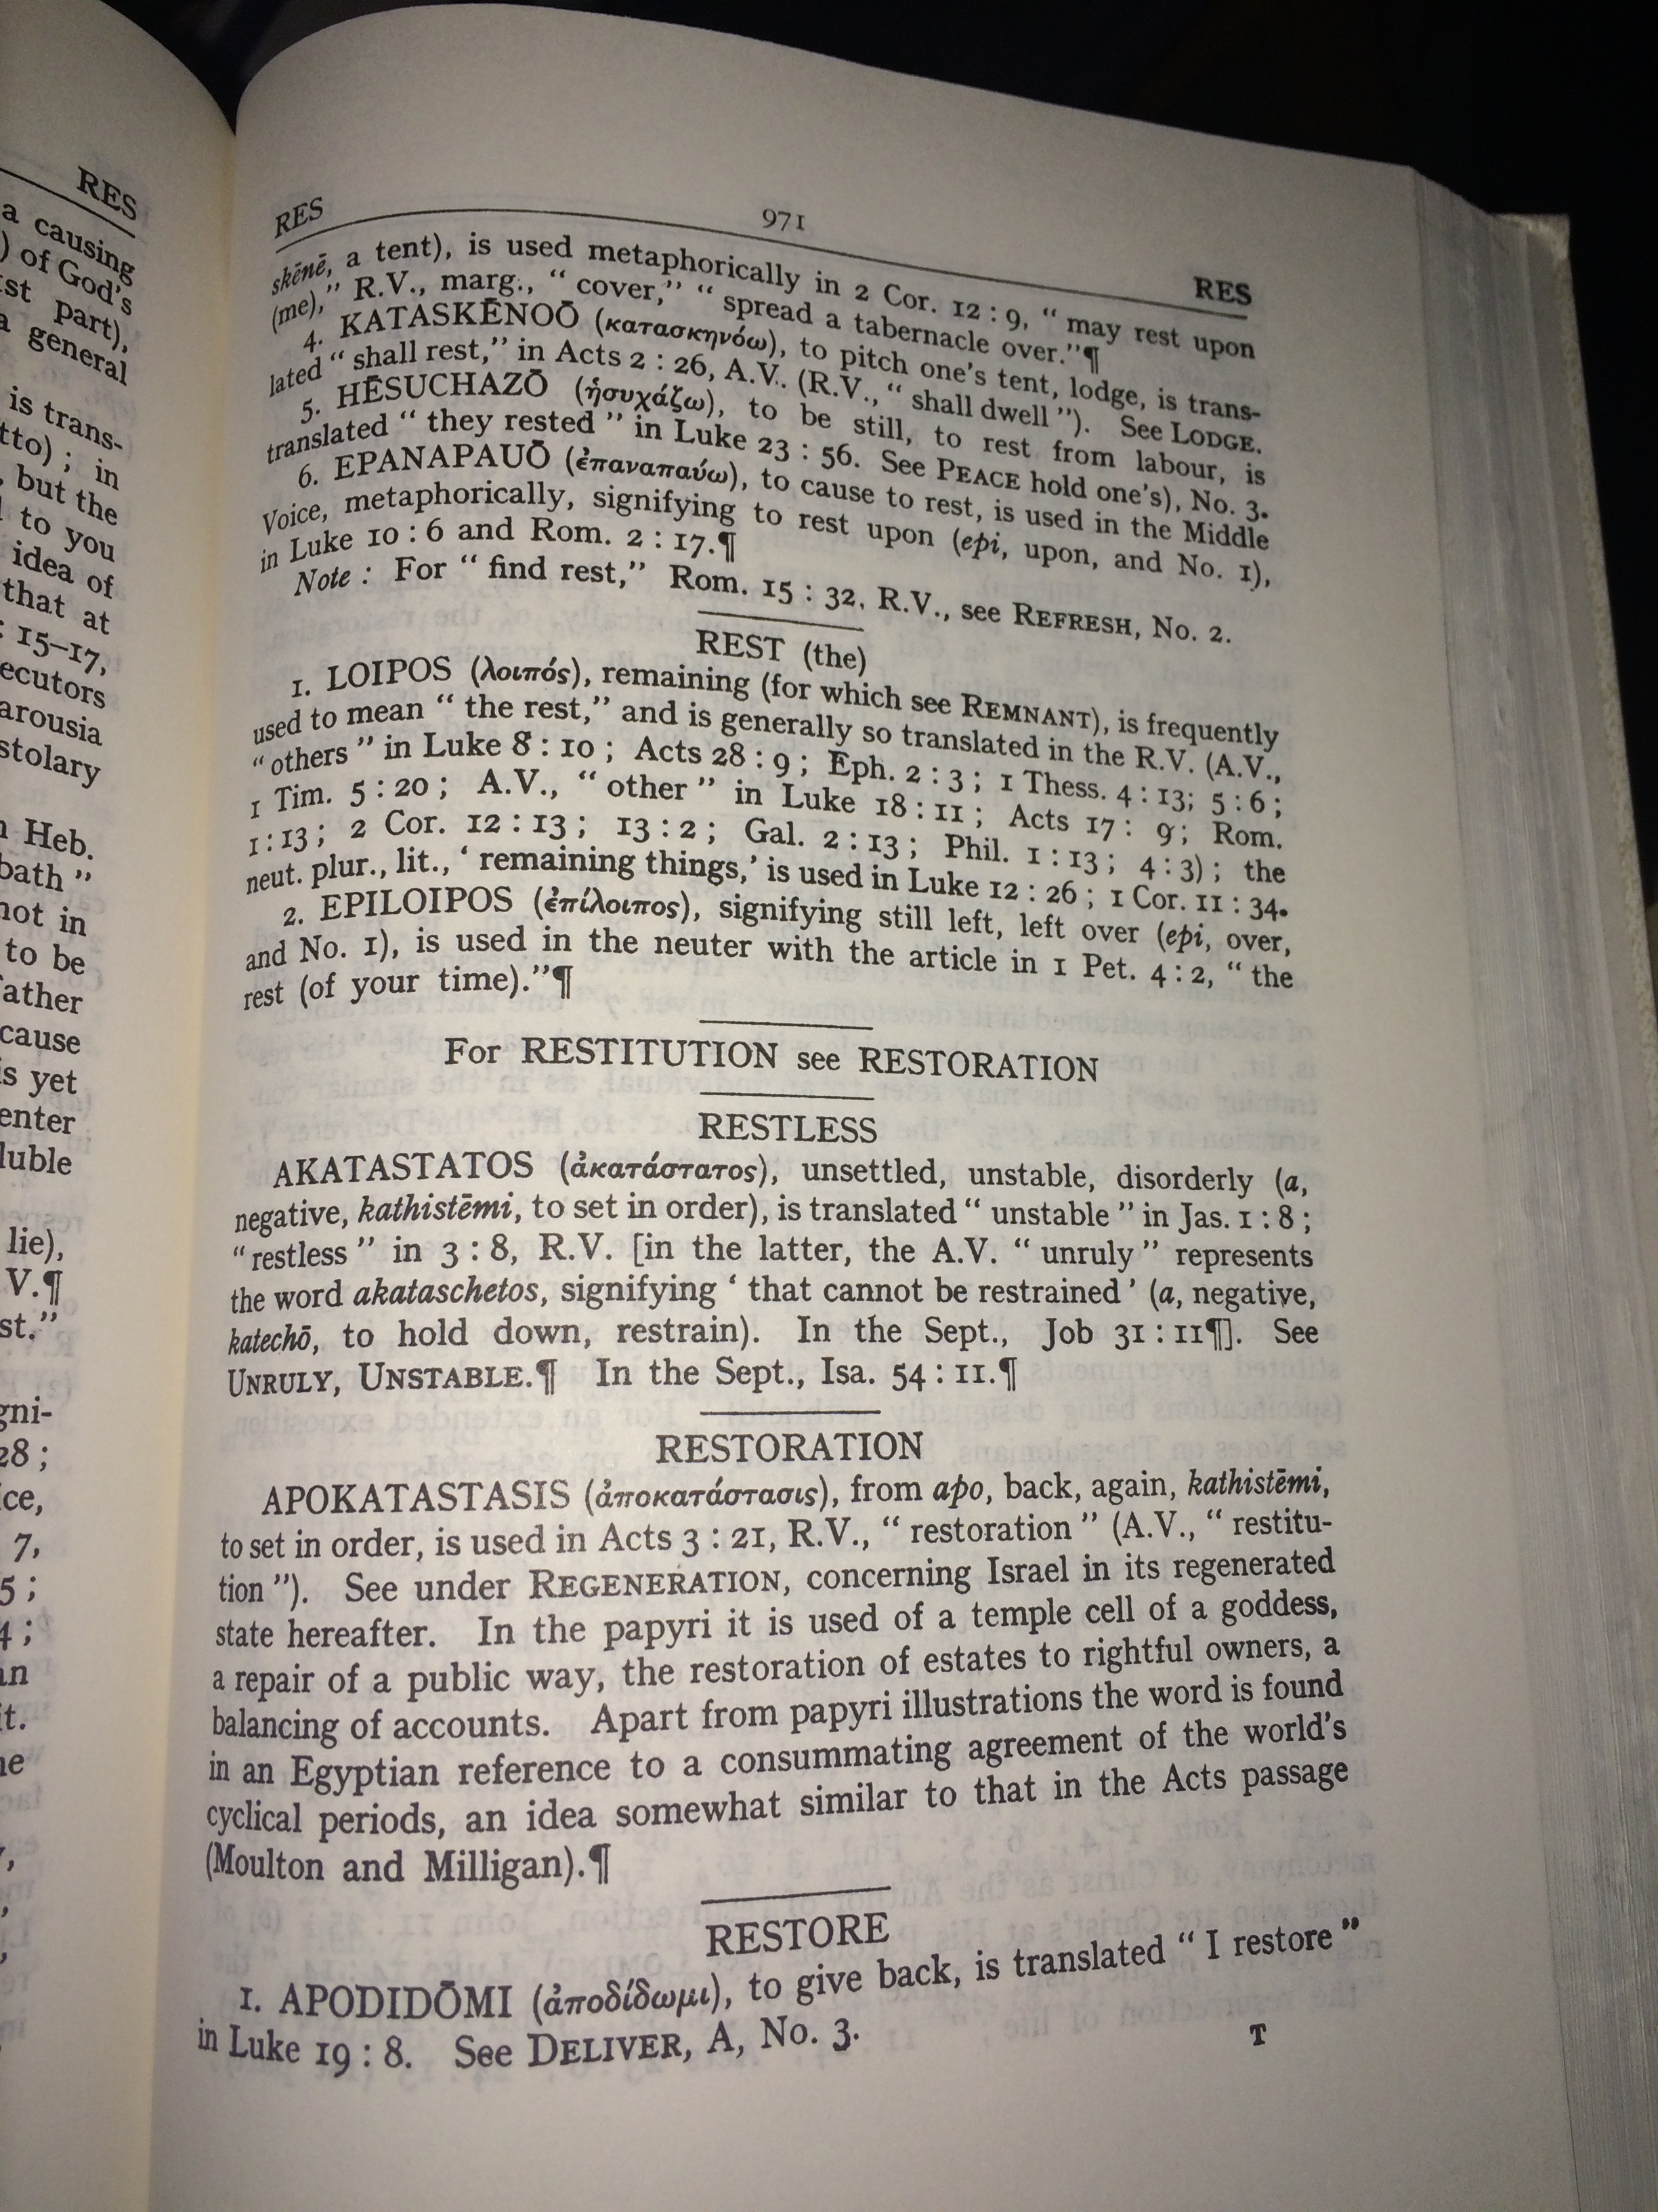
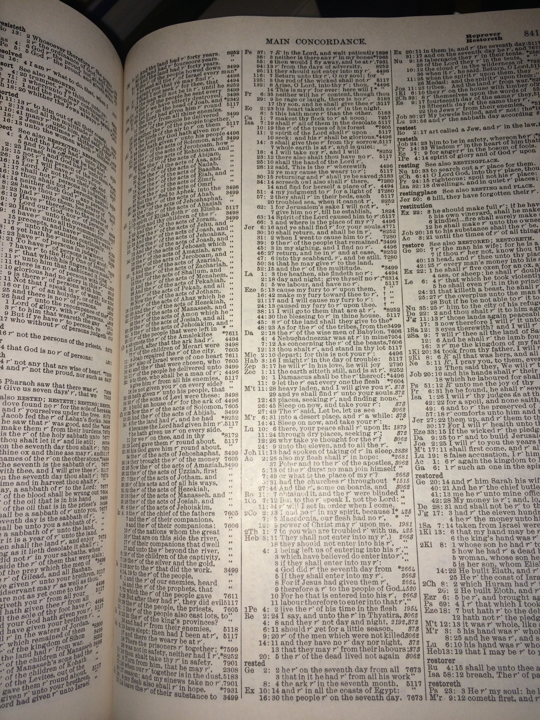
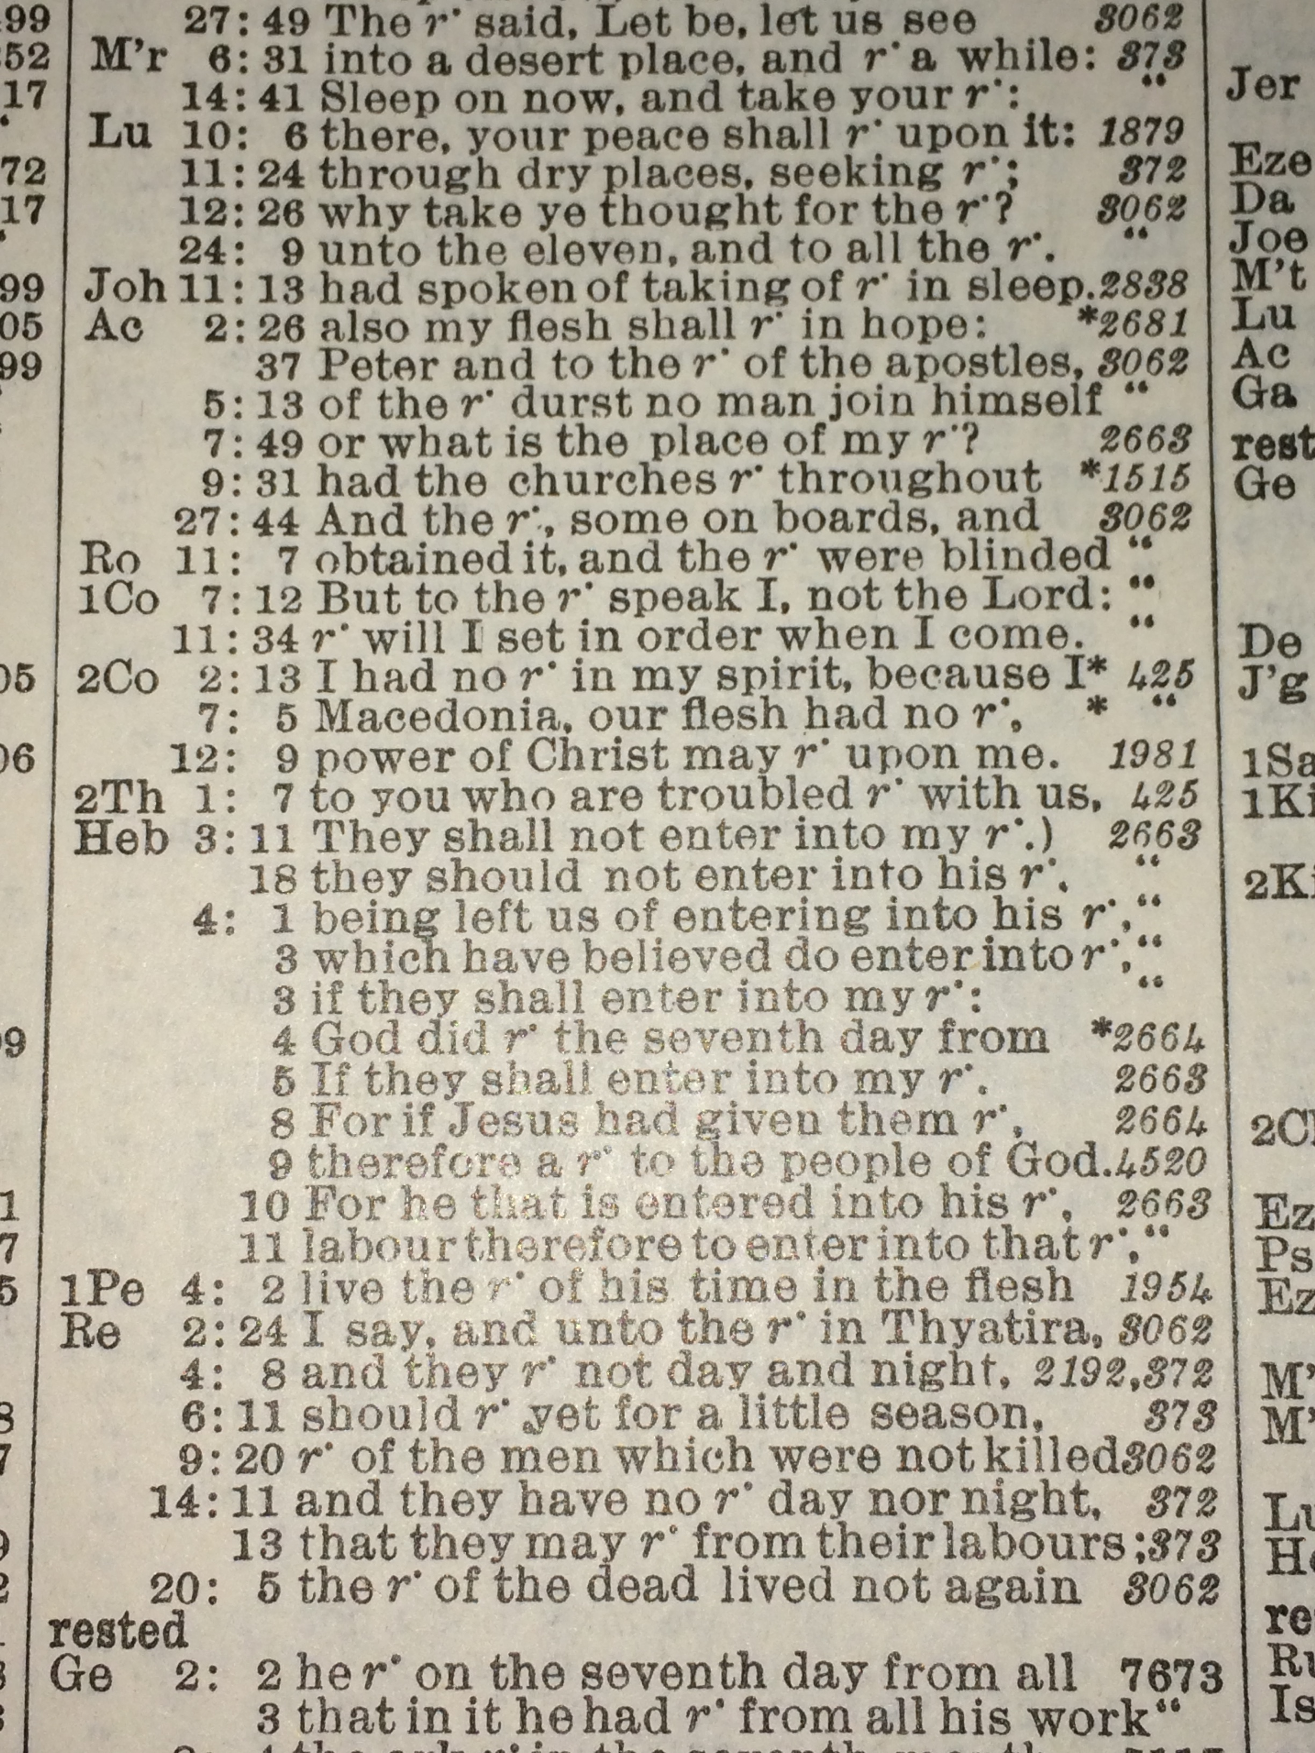
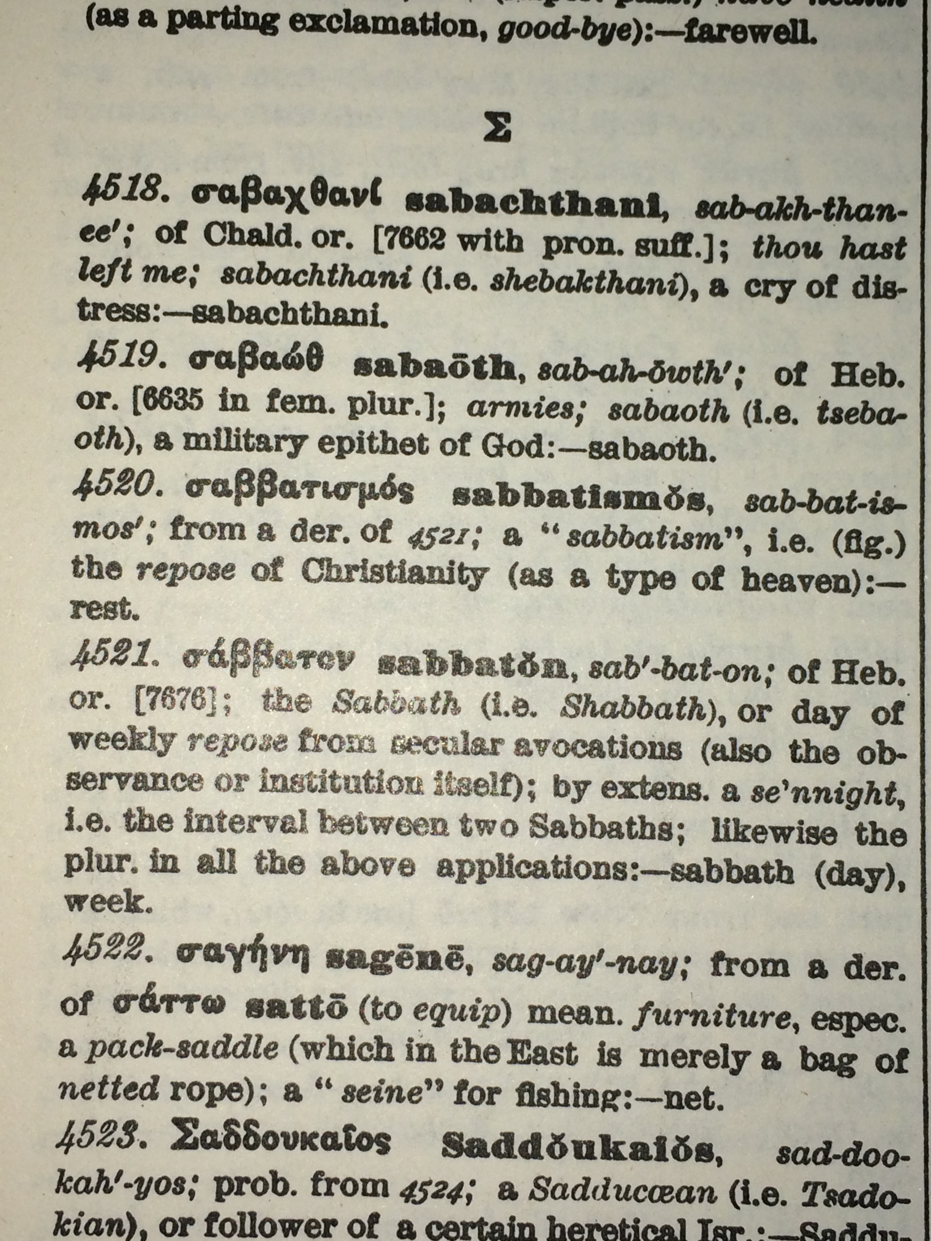

Slide 17
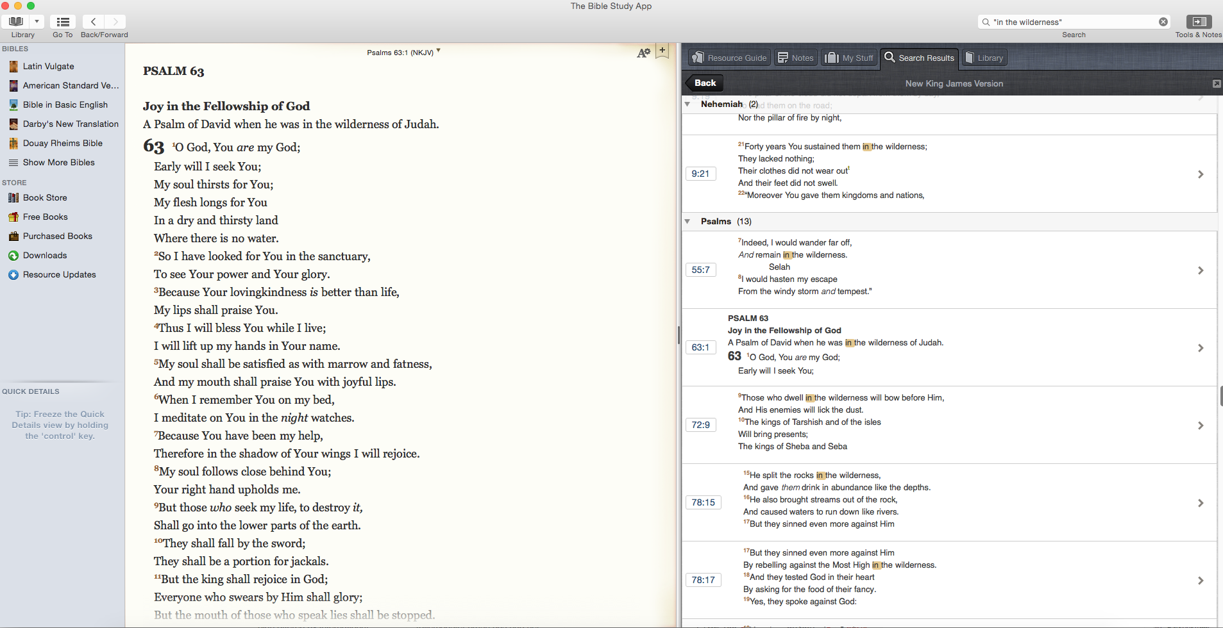
How?
Phrase study
Similar to the word study, perhaps you notice or identify a phrase that you have read in a number of passages
Use your online search tool to identify references to that phrase
Again, look at the background to some of the words
IDEA: Take the phrase ‘in the wilderness’ and follow through the references – ask the same questions each time it occurs:
  Where was their wilderness?
  How did they get there?
  What three lessons did they learn in the wilderness?
  How does this apply in my wilderness? What are the lessons for me?
Going through chapter by chapter and verse by verse is really the best way to get to grips with Bible study
BUT there are other ways
Try some of these…

Slide 18

How?
Thematic study
Identify a theme or topic that is of interest to you – perhaps something that has come up in a reading or that you have heard spoken about in a meeting
Read about that theme in passages you already know
Look up other references
IDEA: Take the idea of morality / relationships / marriage:
  What are the key passages you can find?
  What do the scriptures teach (Old and New Testament)?
  How does this contrast with what the world teaches?
  How can you live this out?
  What help might you need from others?
Going through chapter by chapter and verse by verse is really the best way to get to grips with Bible study
BUT there are other ways
Try some of these…

Slide 19
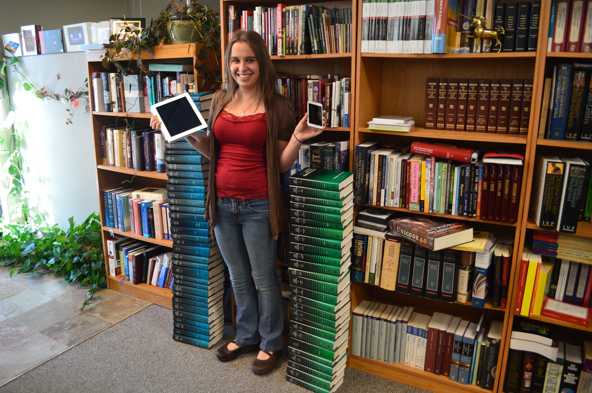

How?
What about commentaries?
Useful tools to support our Bible study
Try to make them one of the last things you consult – there is no substitute for working things through for yourself with God’s help
Don’t ever let them take the place of the Bible itself
Find reliable and recommended commentaries that will help you get to grips with the text
Old ones are often better!
Don’t just rely on online tools – you can’t beat real books!

Slide 20

What next?
If you are already doing this…don’t stop! Encourage others!
If you are not in the habit of regular Bible study, give it a go.
Try half an hour to an hour per week to start with and build up from there.
Start with a gospel (Mark or John) or maybe an epistle like Philippians
Use these notes to help and guide you.
Once you’ve started – don’t give up!
Find someone to share your learning with.
Pray for commitment, guidance and that you will be able to put what you learn into action.
Go for it!
https://www.dropbox.com/sh/l6kur01d2yoeur3/AAC8xA6b-xXiVerG4R7JrErca?dl=0

