Slide 1
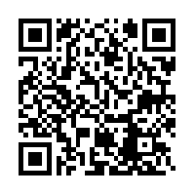
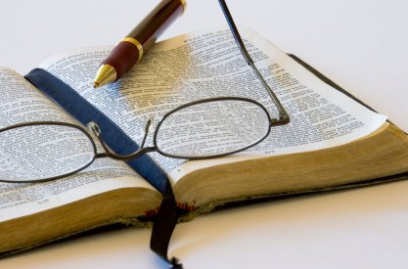
Why should I Study My Bible?
1. Because of what it is
2. Because it demands a response
3. Because it is pleasing to the Lord

Slide 2
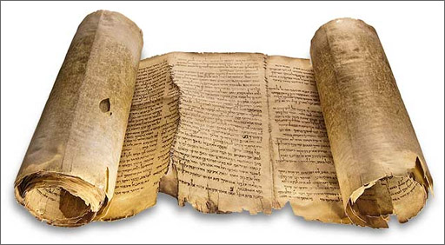
given by inspiration of God 2 Timothy 3:16
Because of what it is
The Bible is
We believe that the scriptures are ‘God-breathed’.
We believe in plenary inspiration – it is all of God.
We believe in verbal inspiration – every word is of God, not merely the ideas, even though we see the writer’s character.
It is distinct from any other (sacred) and utterly free of error.
‘Holy men of God spoke as they were moved by the Holy Spirit.’ 1 Peter 1:21

Slide 3
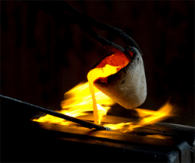
Pure, PERFECT, SURE
Proverbs 30:5,6; PSALM 19:7
With such completeness in itself, that no part can be dispensed with, there is neither need nor room for any additional part or parts. Collett
The Word of God is...
It is ‘found pure’ – it has been tested and refined.
The Word of God passes every test it is put under.
There is no defect in it whatsoever and nothing can be added.
It is sure, steadfast and certain – we can rely upon it completely.
It changes lives – converts / restores and brings wisdom / rejoicing / enlightenment.
‘Whatever I command you, be careful to observe it; you shall not add to it nor take away from it.’ Deut 12:32
Because of what it is

Slide 4
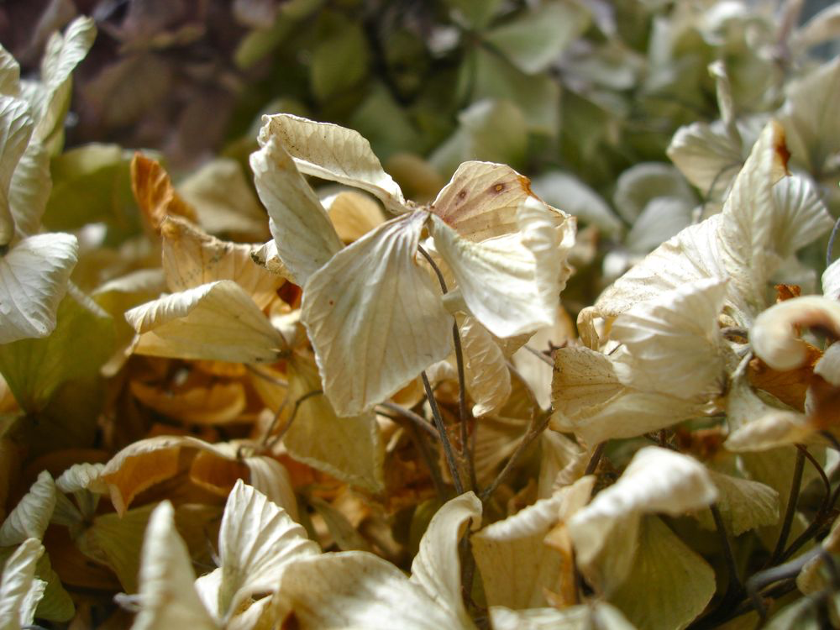
lives and abides for ever
1 Peter 1:23
When this life is but a memory, God’s Word will still stand. Bennett
The Word of God...
This is in complete contrast to everything of man – which withers and falls away v24
It is alive and it remains – it will never die and never fade away.
‘The word of the Lord endures for ever.’ v25
This is the same word that we first believed – it has not changed.
Because of what it is

Slide 5
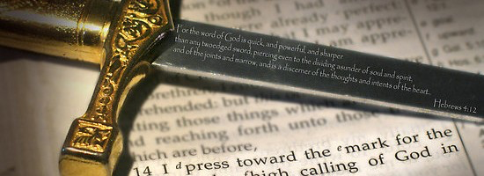
living and powerful Hebrews 4:12
‘And take…the sword of the Spirit, which is the Word of God.’ Eph 6:17
The Word of God is...
Because it is alive, it is powerful – remember how often Israel knew the powerful sword of the living God.
It is sharper than a sword: piercing, uncompromising.
It is capable of dividing soul and spirit – distinguishing that which is natural from that which is spiritual.
It exposes our every thought and motive – we are laid bare before God.
Because of what it is

Slide 6
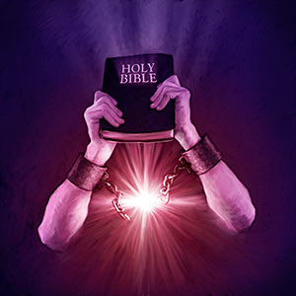
not chained
2 Timothy 2:9
The Word of God is...
As human beings we have many limitations.
Paul is in chains as he writes to Timothy.
The Word of God cannot be restrained even though his servants may be.
The word chained/bound is also translated ‘hanged’ in five other places – nothing can be done to limit or eradicate the scope and effects of God’s Word.
Because of what it is

Slide 7
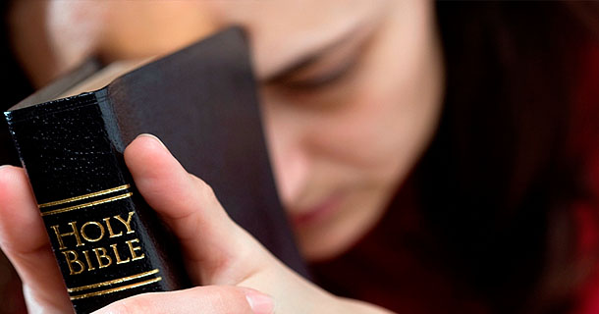
able to bring salvation
2 Timothy 3:15
So many hunger, so many blind. Starving for words they must wait in the night, to open a Bible and move t’wards the light. Card
The Word of God is...
The Scriptures bring wisdom that points people to salvation through faith in Christ.
This is the whole essence of the Bible – to make Christ known to men and women.
There is nowhere else to look for salvation. So many books claim to provide salvation, only this one can!
Because of what it is

Slide 8
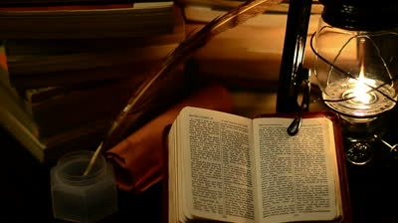
a lamp and a light
Psalm 119:105
Each man should use the Word of God…that he may see his way and what lies in it. Spurgeon
The Word of God is...
It is something that illuminates.
The lamp shows the feet the next steps to make.
The light shows the path to the final destination.
The Word of God provides us with the guidance and direction that we desperately need in our lives.
‘The entrance of Your words gives light.’ Psalm 119:130
Because of what it is

Slide 9

Profitable
2 Timothy 3:16
Open to us Thy Word, Thy precious thoughts reveal,
Thy purposes and ways explain, and teach us all Thy will. Webley
The Word of God is...
There is something for us in this book – if all these things are true, it must be profitable; useful; do us good.
For doctrine – teaching us what we should do.
For reproof – testing our lives against God’s standard and bringing conviction.
For correction – putting right what is wrong.
For instruction – training us in God’s standards.
Because of what it is

Slide 10
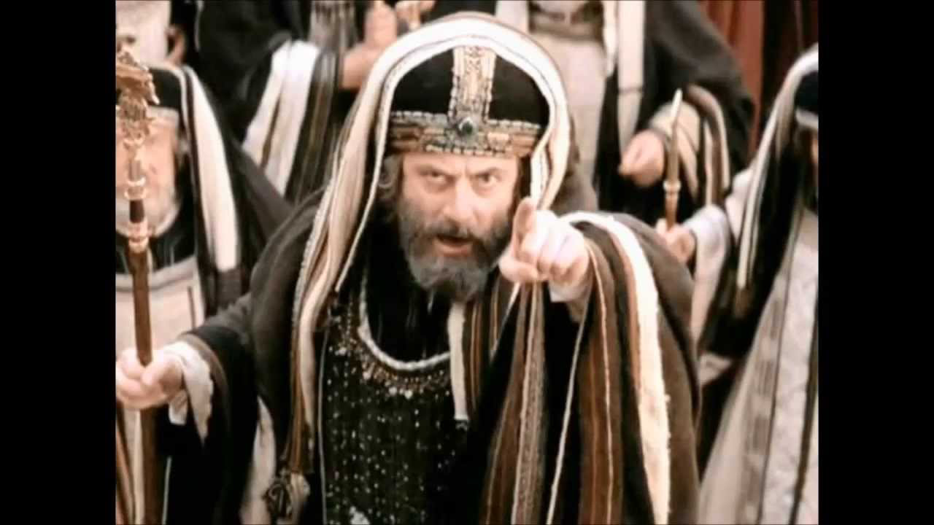
Making it of no effect
Mark 7:13
Because it demands a response
The Word of God
We start here with a word of caution.
The idea behind this phrase is literally to ‘deprive of authority’.
What a tragedy if this is what happens - if we forget all that has gone before and we, by our traditions, nullify the authority of God’s Word.
Let us challenge everything by the Word of God and not by the ‘tradition of the elders’ (v5)
God save us from being Pharisees.
For you shut up the kingdom of heaven against men. Matthew 23:13

Slide 11
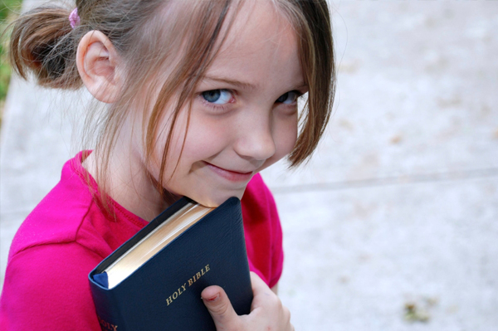
Delight in it
Psalm 1:2
Loving delight in the law which no prosperity, nor adversity, nor the world, nor the prince of it, can either take away or destroy. Luther
The Word of God
This clearly indicates that the reader takes great pleasure in the text.
How much do I really enjoy God’s Word?
How much does it become a chore?
There are so many things in which I find pleasure for a season but here is something that should always be a delight.
Because it demands a response

Slide 12
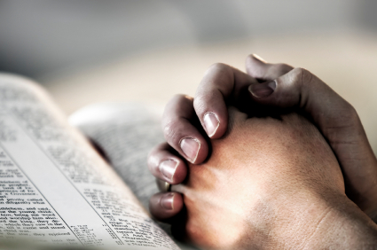
Meditate in it
Psalm 1:2
The blessed man who so continually meditates will be like a firmly planted tree…flourishing by the refreshing rivers of communion with God. Flanigan
The Word of God
‘Meditate’ appears in various forms on 21 occasions in the Psalms.
This is possibly an onomatopoeic word that reflected the sighing and low sounds that may be made while musing upon a text.
How much time do we really spend meditating on God’s Word and communing with him?
Because it demands a response

Slide 13
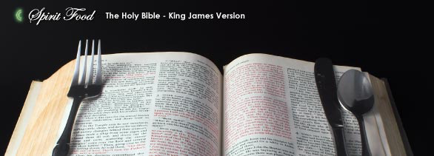
Live by it
Luke 4:4
The Word of God
The words of the Lord Jesus facing temptation.
The Word of God should be my daily food to live by.
I need it for sustenance, for vitality and for health.
I would not neglect to eat regularly – how much more the Word of God?
It is my milk 1 Peter 2:2 and my meat 1 Cor 3:2. I need to be taking the solid food.
Because it demands a response

Slide 14
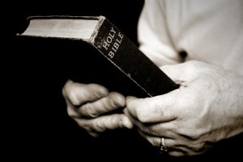
Keep it
Luke 11:28
Hold fast the pattern of sound words which you have heard from me. 2 Tim 1:13
The Word of God
We need to guard and protect that which we have gleaned from God’s Word.
The devil loves to snatch what God wants us to hold.
We need to hold it in such regard that we cling to it for all we are worth.
Simply to hear it is not enough – we have to actively hold on and we will only do so by diligent study.
Because it demands a response

Slide 15
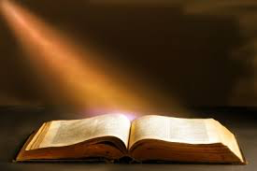
Hope in it
Psalm 119:81
I hope in your Word. Psalm 119:81
The Word of God
There are times when we feel all is against us.
Here the Psalmist is looking for comfort and deliverance.
He discovers his only hope is in God’s Word.
Do I turn to it for help in the daily trials of life or do I look for hope in all the wrong places?
When all else seems hopeless, I can hope in it.
Because it demands a response

Slide 16
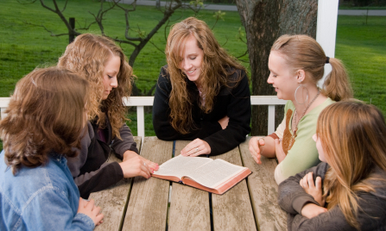
Preach it … Speak it
2 Timothy 4:2 Acts 4:31
I preached as never sure to preach again, and as a dying man to dying men. Rutherford
The Word of God
Although the world may seem indifferent, still we are to herald it forth.
We are to convince, rebuke, exhort – these are all a vital part of the preaching of the Word.
Wherever they went they talked boldly to others.
How often are we guilty of being apologetic in our presentation of God’s Word to others?
Because it demands a response

Slide 17
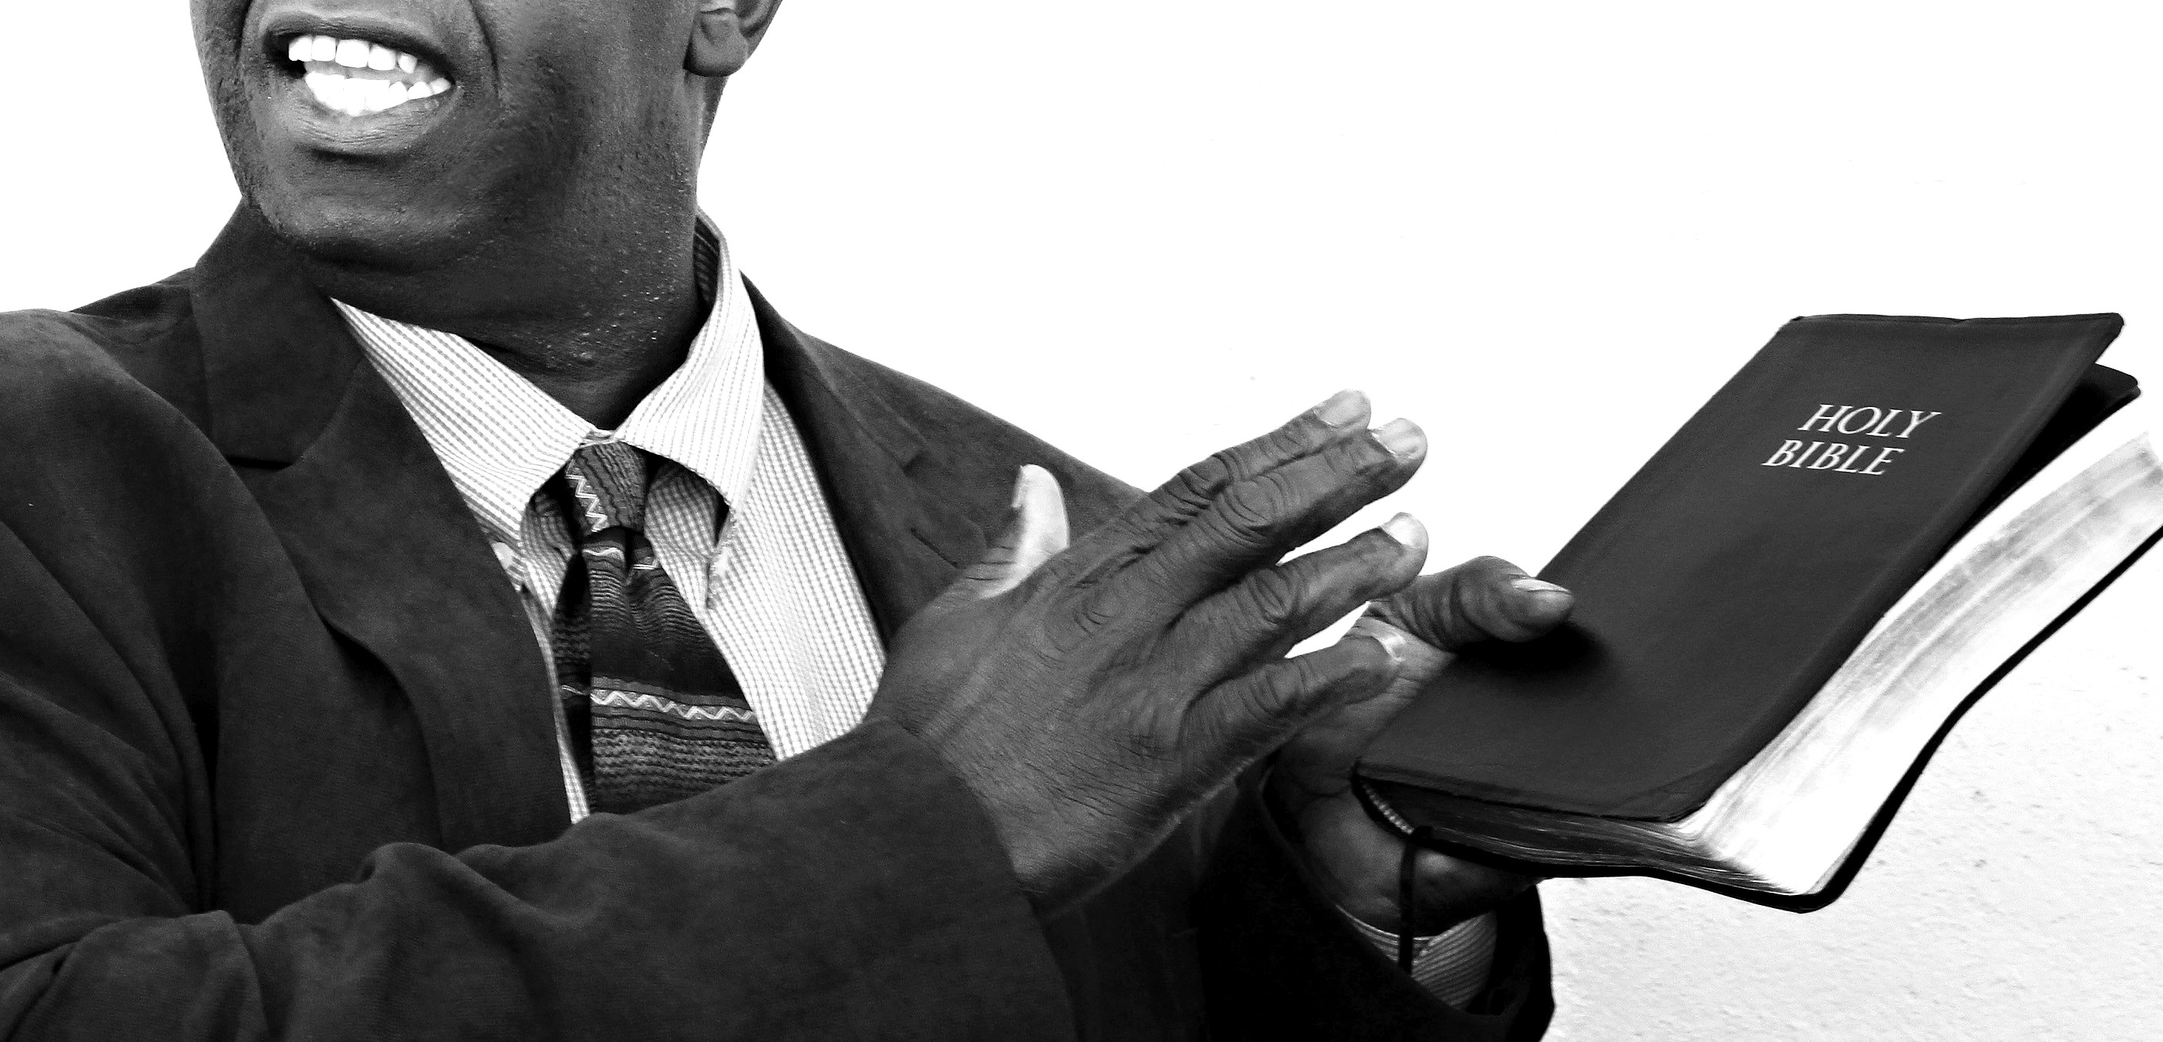
Teach it
Acts 18:11
Oh, teach me Lord, that I may teach the precious things thou dost impart
Havergal
The Word of God
The Word of God needs to be delivered in such a way that others can learn.
Here Paul continues for a year and six months.
The teaching must have been consecutive, thorough and relevant to their needs.
In the verses that follow we discover that it clearly had an impact.

Slide 18
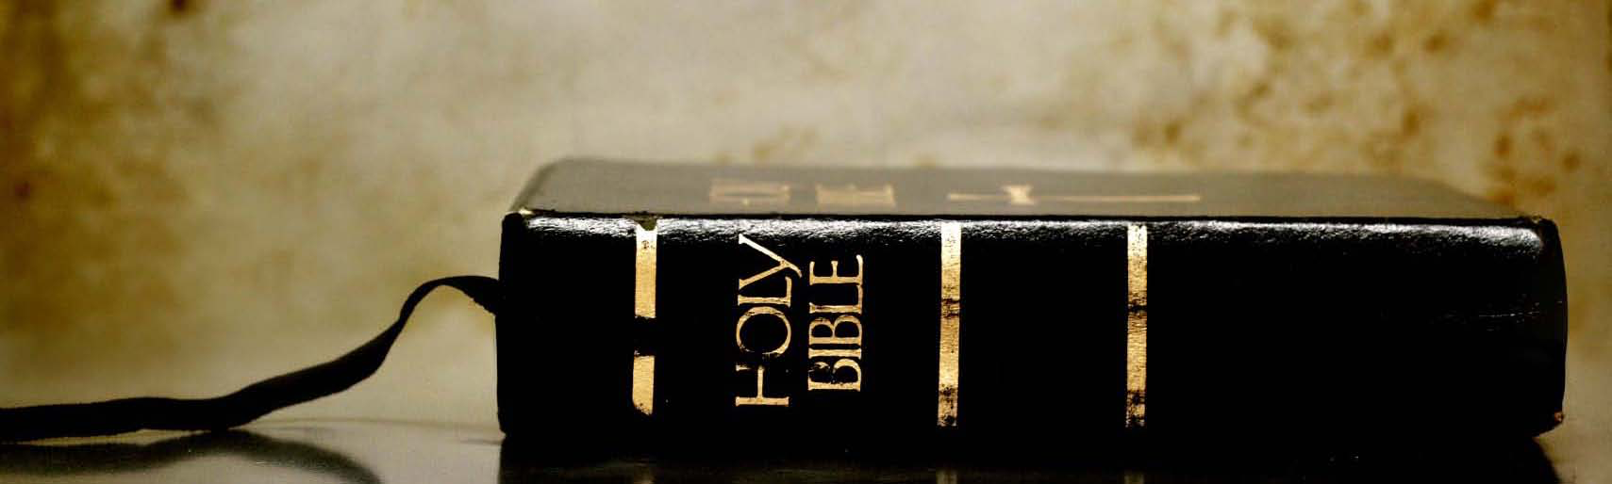
Do it
James 1:22
He who has an ear, let him hear… Revelation 2:7
My mother and my brothers are these who hear the word of God and do it. Luke 8:21
The Word of God
We hear so much and we perhaps try to listen well.
But what impact does it make?
The reading and study of the Word of God should lead to real results in our lives.
Why make excuses?
Why respond in the wrong way?
JUST DO IT!
Because it demands a response

Slide 19
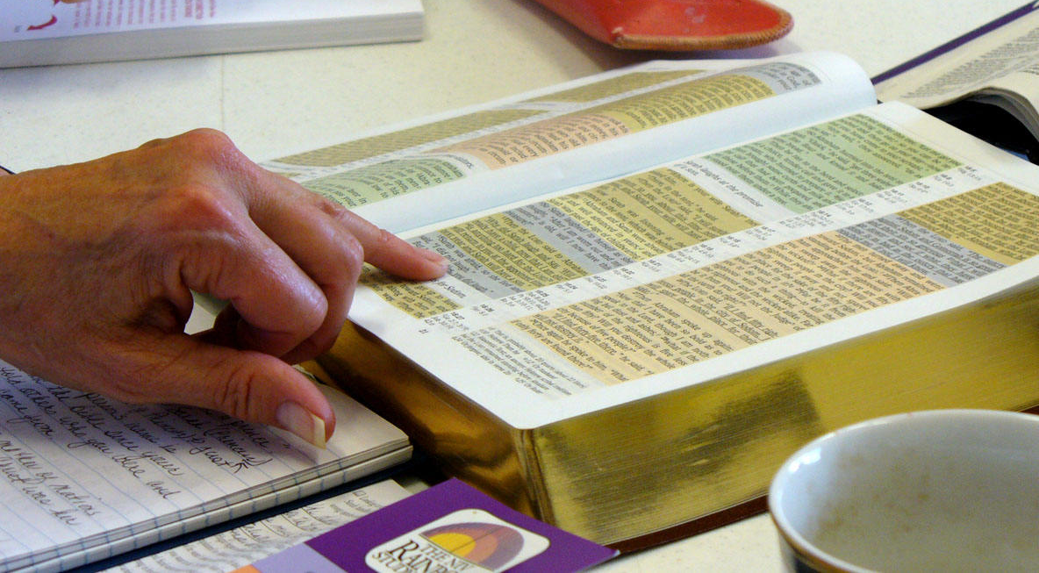
The Word of God is...
given by inspiration of God 2 Timothy 3:16
pure Proverbs 30:5,6
perfect and sure Psalm 19:7
lives and abides for ever 1 Peter 1:23
living and powerful Hebrews 4:12
not chained 2 Timothy 2:9
able to bring salvation 2 Timothy 3:15
a lamp to my feet and a light to my path Psalm 119:105
profitable 2 Timothy 3:16

Slide 20
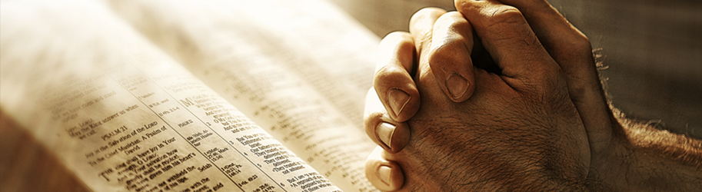
My response to the Word of God
Making it of no effect Mark 7:13
Delight in it Psalm 1:2
Meditate in it Psalm 1:2
Live by it Luke 4:4
Keep it Luke 11:28
Hope in it Psalm 119:81
Preach it 2 Timothy 4:2;
Speak it Acts 4:31
Teach it Acts 18:11
Do it James 1:22

Slide 21
Why should I Study My Bible?
Because it is pleasing to the Lord
Study (be diligent) to shew thyself approved unto God, a workman that needeth not to be ashamed, rightly dividing the word of truth
2 Timothy 2:15

